Slide 1
Towards Predictable and Efficient Datacenter Storage
Huaicheng Li
Carnegie Mellon University
Research Areas: Operating Systems; Storage Systems
Notes:
Thank you for the nice introduction.
Hello everyone, very excited to be here.
Today I’m gonna talk about my research on improving the storage stack for predictable latencies and efficiency using a software and hardware co-design approach.

Slide 2











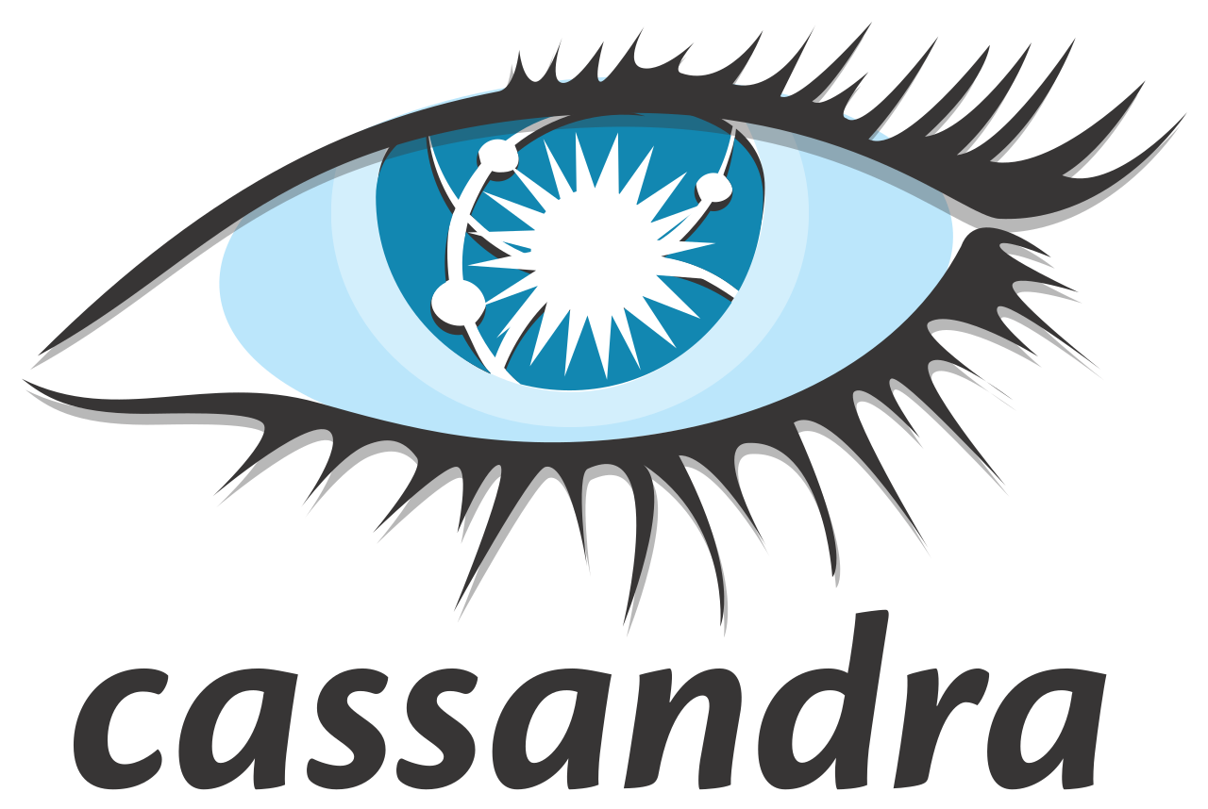








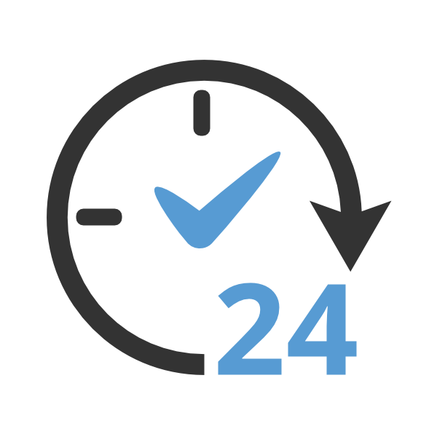


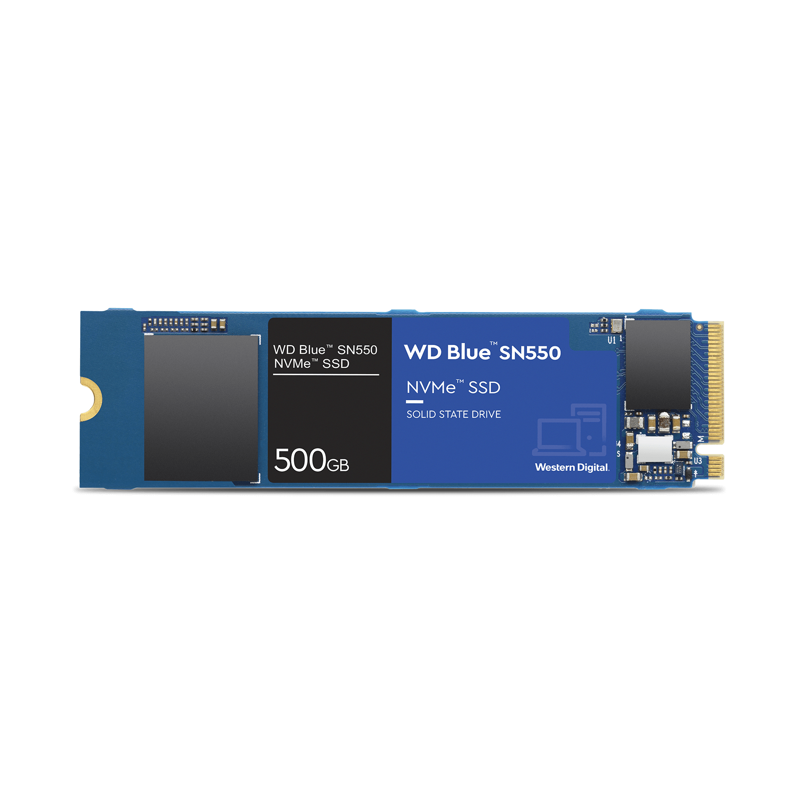
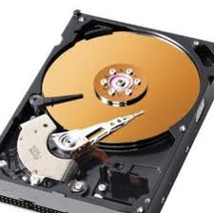
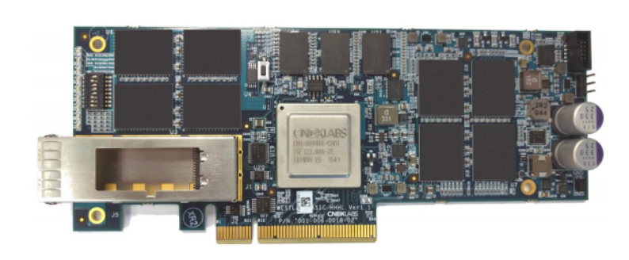
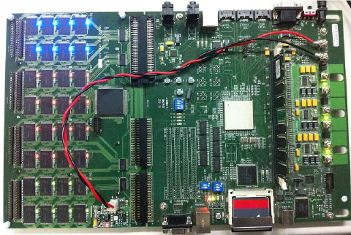
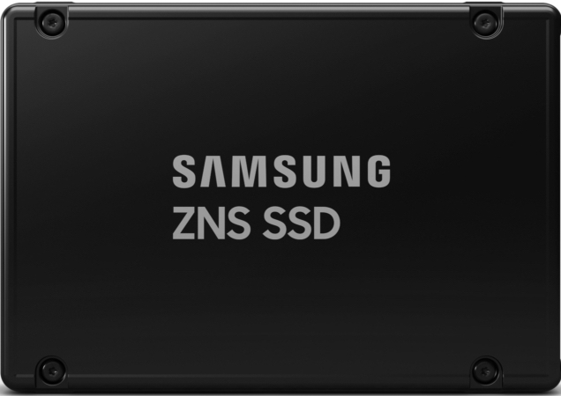
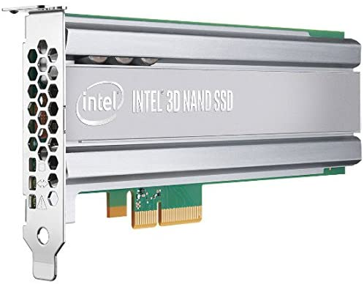
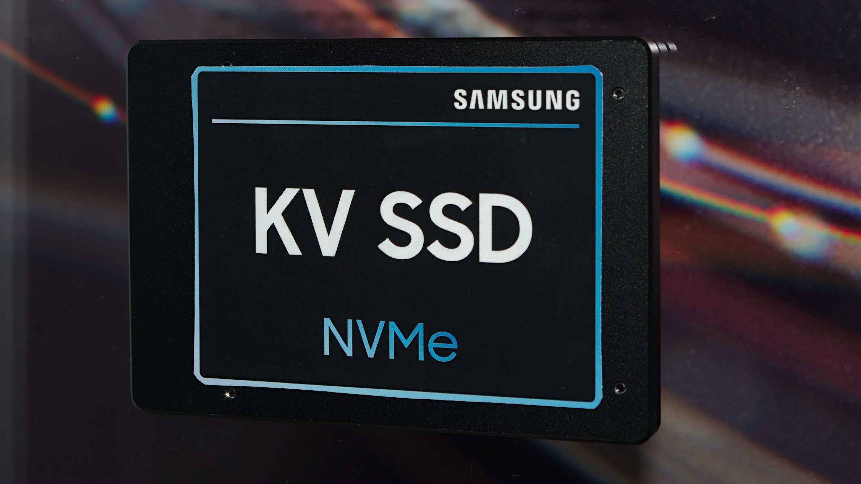
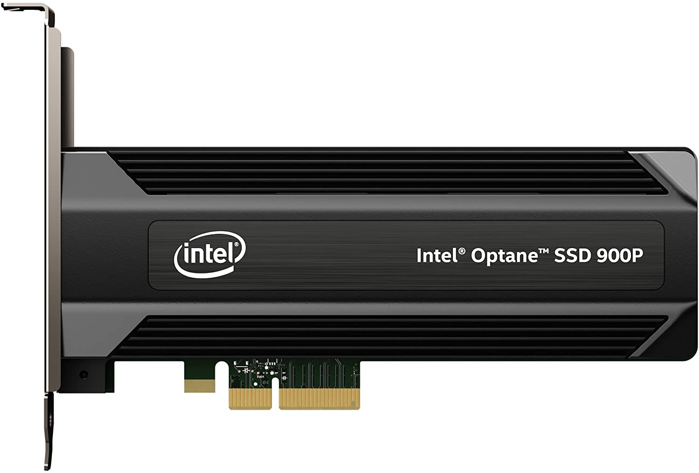
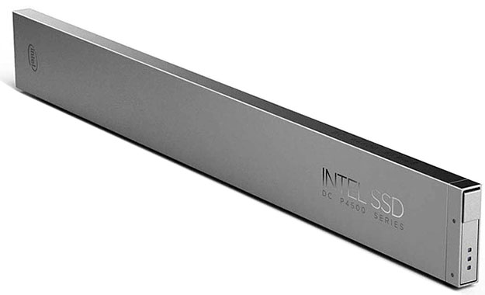
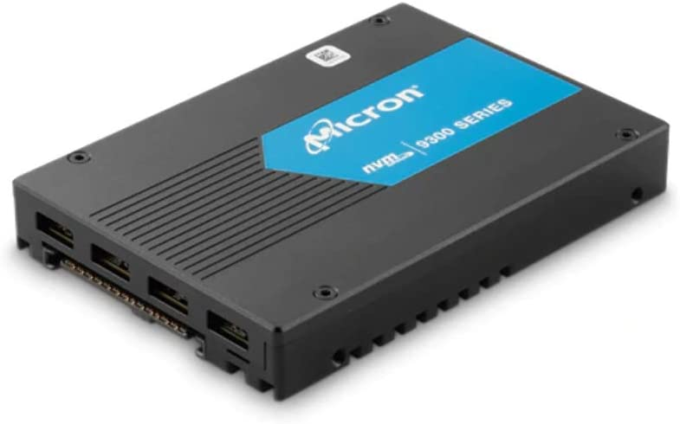
Reliability
QoS
Security
Efficiency
Availability
Scalability
Cloud Datacenter Storage Stack
Cloud Datacenter
Notes:
Many services store their backend data in cloud datacenters.
(click) And they heavily on the storage stack to manage the underlying hardware and satisfy various user demands, such as reliability, QoS and availability guarantees and so on.

Slide 3


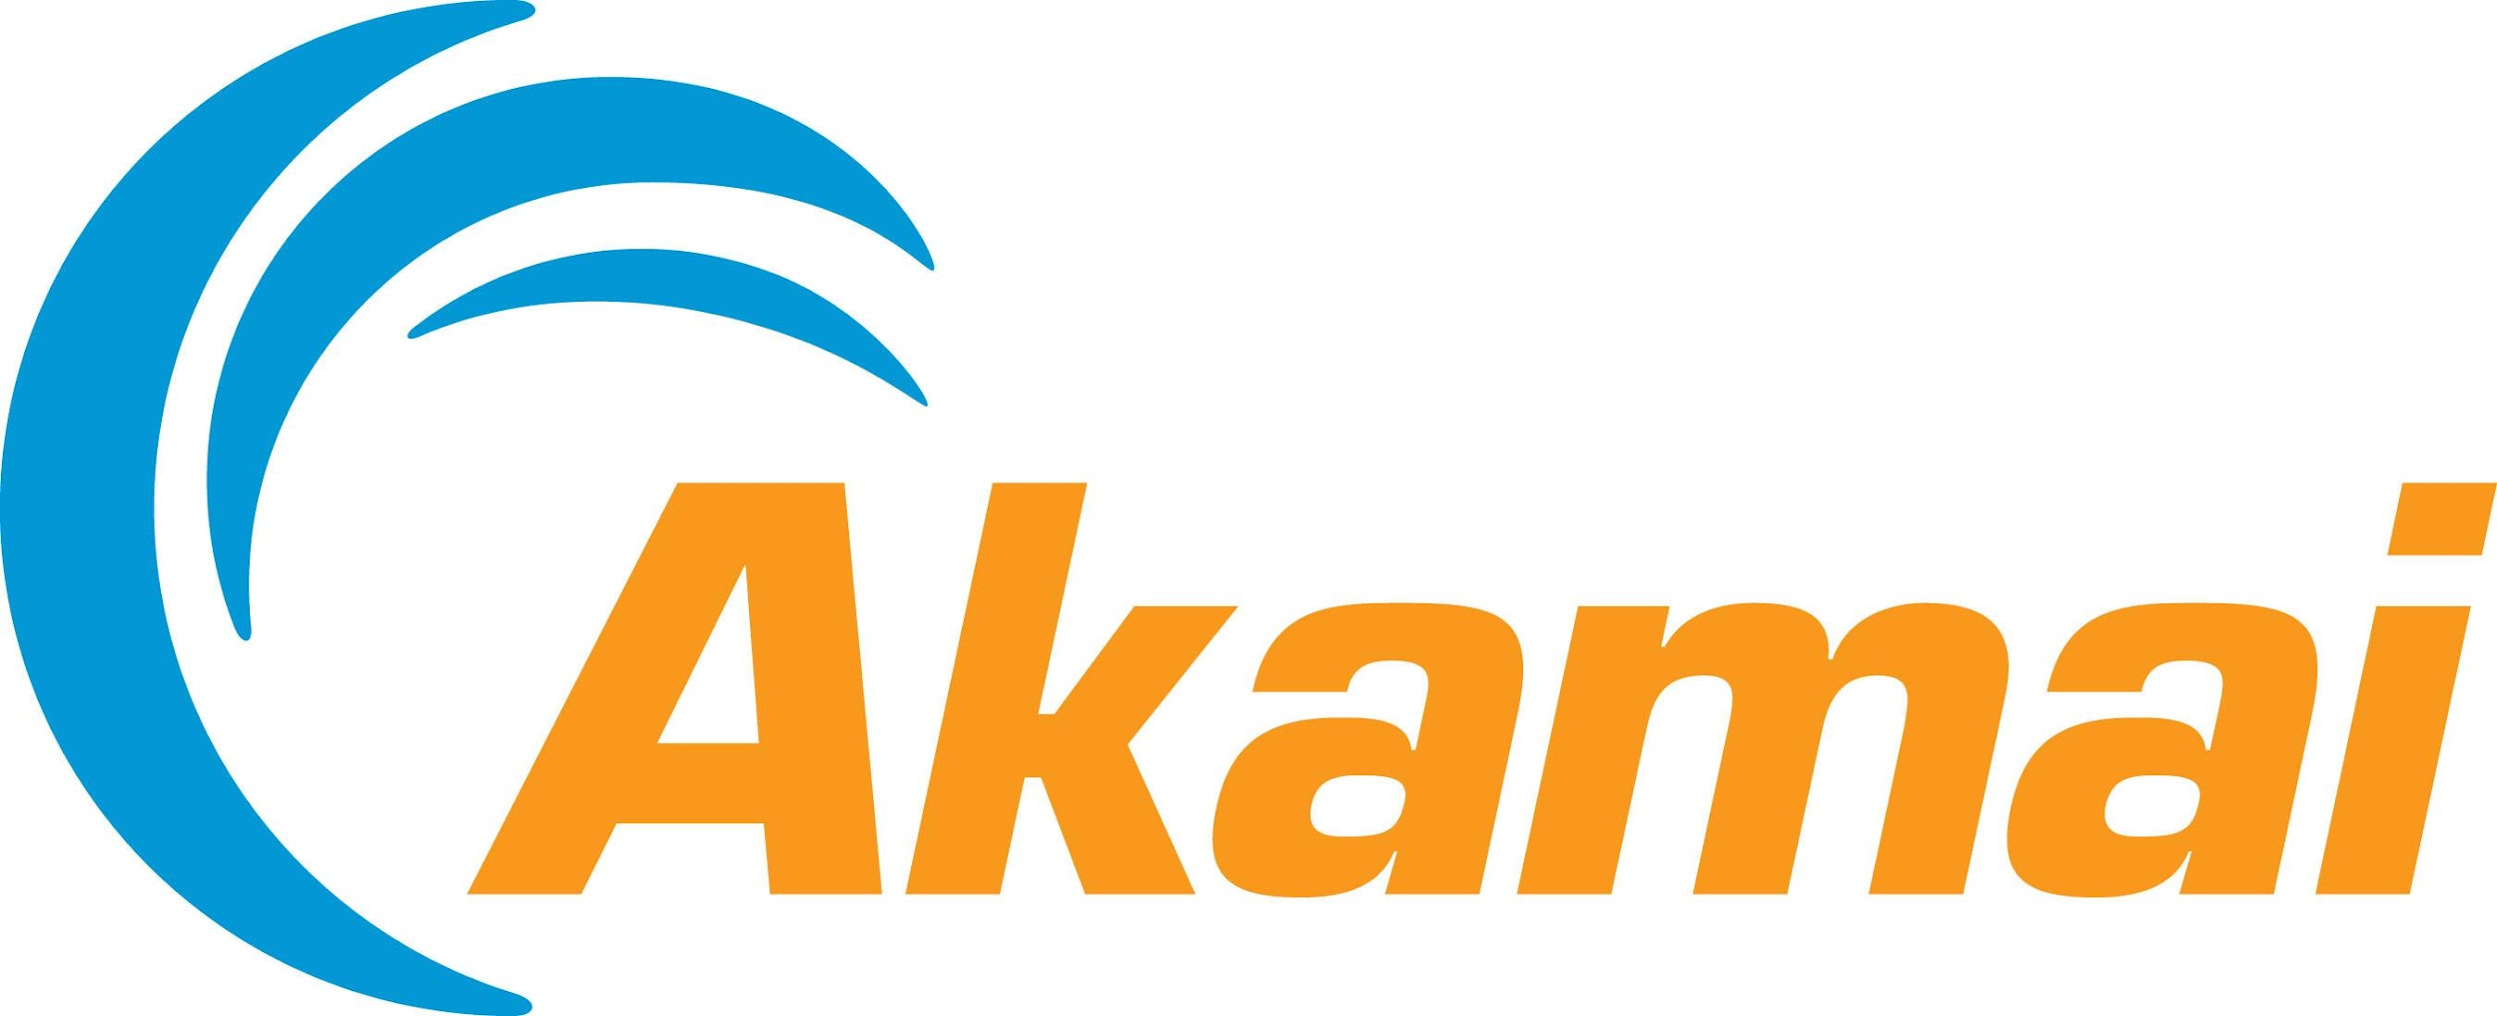


Need for Predictable Performance and Efficiency
Low Latency Matters!
Hunger for Efficiency
+100ms -1% sales
Even small improvements in CPU efficiency can save millions of dollars.
+100ms -7% users
Using machine learning to wring even more efficiency out of its mighty data centers.
+500ms -20% traffic
“Can't wait for ARM to power MOST of our cloud data centers!”
How to build performant and efficient datacenter storage systems for modern hardware?
+1ms -$100 million
[1] Large-scale cluster management at Google with Borg, EuroSys 2015
[2] datacenterknowledge.com/google-using-machine-learning-boost-data-center-efficiency, 2014
[3] https://www.theregister.co.uk/2017/03/09/microsoft_arm_server_followup, 2017
Notes:
Among these requirements, predictable performance and efficiency are two main driving factors for the success of modern cloud storage!
On the performance front, high latency can cause severe consequences.
(click) For example, Amazon reports that every 100ms latency costs 1% in sales,
(click) and a 100ms delay in web page loading will lose 7% of the users.
(click) Similarly, Google observes that half second in search page generation time would drop traffic by 20%.
(click) Even worse, in high frequency trading, a broker might lose 100 million dollars for each extra ms latency.
(click) Thus, offering Low and Stable latencies is very important.
Furthermore, cloud providers not only want their services to run fast, but also efficient at low-cost.
(click) In large-scale datacenters, even very small improvements in CPU efficiency can save millions of dollars,
(click) and this has recently motivated Google and
(click) and Microsoft to seek new software and hardware approaches to squeeze more efficiency out of their highly optimized datacenters.
(click) The need for stable and low latencies as well as CPU and cost efficiencies never ends.
(click) Overall, there are new surging challenges to design performant and cost-efficient cloud storage systems under the hood of modern storage hardware.

Slide 4

Storage Software/Hardware Trends
Software
Not keeping up: aged interfaces/abstractions; deep
A widening gap between
what hardware promises
and
what software can extract
Hardware
New capabilities: high performance; extra compute
But more complex: heterogeneity; idiosyncrasies
…
SSD
ARM
Notes:
The world of storage is changing rapidly in both software and hardware. And maintaining high end-to-end performance in an efficient manner is becoming more difficult.
(click) With the rise of I/O and computation acceleration, modern hardware brings new capabilities, such as much higher I/O processing speed in NVMe SSDs, and additional computational power in Accelerators.
Thew new hardware also bring a downside, they make today's computing landscape more heterogeneous and complex due to a lot of idiosyncrasies and complexities with the hardware design.
Normally, we rely on the software stack to deliver hardware promised benefits to the upper-level applications.
(click) Unfortunately, the software stack is not keeping up, it is being held back by aged interface and abstraction designs, oblivious of the low-change complexities, with a deep software stack.
(click) As a result, we see a widening gap between what the hardware promises and what software can extract, incurring unpredictable latencies and high overhead.

Slide 5

Storage Software/Hardware Trends
Performance Predictability
More feature-rich
Software
More complex
Hardware
SSD
Faster: 1million IOPS at ~100us
☺
Unpredictable: flash intricacy
Notes:
For example, to serve ultra low latency,
(click) providers have upgraded their hardware with fast SSDs capable of (click) processing million IOs per second at sub-hundred microsecond latencies.
(click) However, SSDs also suffer from idiosyncrasies associated with NAND flash management, making it hard to deliver consist performance.
(click) On the software side, the software stack is becoming more and more feature-rich due to increasing user demands.
(click) But in the meanwhile, the deep storage stack is also becoming the new bottleneck.
(click) Overall, these make the performance predictability challenging to achieve.

Slide 6

Storage Software/Hardware Trends
Performance Predictability
Resource
Efficiency
More feature-rich
Offloading fixed functions
Software
More complex
Not end-to-end
Hardware
SSD
x86
ARM
Faster: 1million IOPS at ~100us
More
cost-efficient
☺
Unpredictable: flash intricacy
Difficult to make it performant
‹#›
Garbage Collection
Notes:
For example, to serve ultra low latency,
(click) providers have upgraded their hardware with fast SSDs capable of (click) processing million IOs per second at sub-hundred microsecond latencies.
(click) However, SSDs also suffer from idiosyncrasies associated with NAND flash management, making it hard to deliver consist performance.
(click) On the software side, the software stack is becoming more and more feature-rich due to increasing user demands.
(click) But in the meanwhile, the deep storage stack is also becoming the new bottleneck.
(click) Overall, these make the performance predictability challenging to achieve.

Slide 7
Software/Hardware Co-design for Storage
Revisit interface designs and responsibility divisions
Software
Move up performance-critical management to software
Move down
cpu-intensive
functionalities to
hardware
Software-centric
Co-design
Hardware
…
SSD
ARM
Notes:
Due to the increasing complexity in both IO functionalities and emerging IO and acceleration hardware,
(click) an optimal solution can NOT be easily achieved by looking at software or hardware ALONE.
(click) Given this, I advocate a software-centric co-design approach to revisit the communication interfaces and responsibility divisions between software and hardware. The software-centric codesign scheme aims to extend existing hardware and interface designs with small changes to facilitate software systems designs.
Specifically, (click) I suggest that hardware better expose necessary information to software to bridge the semantic gap for better system-level policy designs. For example, in one of my work, we allow the host software to query SSD’s internal idiosyncrasy status to help achieve more stable latencies.
(click) On the other direction, some software functionalities are better offloaded to the hardware for overall cost-efficiency. And to achieve best performance, we might need to define new hardware properties based on software needs.

Slide 8
Predictable Performance
(OS/Interface/Hardware)
Impact
Contributions
Apps
2nd
MittOS
[SOSP’17]
New principle: SLO-aware vs. best-effort OS abstraction
My findings partially merged to Linux kernel
Operating
System
1st
IODA
[SOSP’21]
New interface: Simple yet powerful OS/SSD co-design
Attracted interest from flash/storage vendors
2nd
ttFlash
[FAST’17]
New architecture: Novel SSD controller architecture design
Best Paper Nomination; Fast-Tracked to ACM TOS
Hardware
NVMe SSD
Plethora of Hardware Acceleration
1st: first-author paper
2nd: second-author paper
Notes:
At high level, my research looks at different layers of the storage stack under different hardware contexts. And many of my work have generated real-world impact.
(click) The first line of my work introduces a holistically design flash storage stack with predictable performance
(click) In more detail, I introduced a new storage interface to enable OS and SSD co-design which delivers always-predictable latencies. This work has recently attracted interest from storage companies for potential integration with their flash array products.
(click) At the hardware level, I re-architected the SSD controller architecture to leverage recent hardware advancements for more fine-grained control.
(click) For its novelty, this works has been nominated for best paper award at FAST and fast-tracked for extended journal publication as research highlights.
(click) At the OS level, I advocate a new system design principle to transform Operating Systems to be SLO-aware, instead of rely-on the traditional best-effort design.
(click) My findings in this work has been partially merged to the Linux OpenChannel-SSD subsystem.

Slide 9
Predictable Performance
(OS/Interface/Hardware)
Cost-Efficiency
(Hypervisor/Hardware)
Apps
Offload-ready cloud storage stack: OS/runtime to satisfy various deployment requirements
2nd
MittOS
[SOSP’17]
Deployed in Microsoft datacenters!
Operating
System
1st
IODA
[SOSP’21]
1st
1st
LeapIO
[ASPLOS’20]
MemDisagg
[InSub’22]
First CXL-based full-stack
memory disaggregation design
2nd
ttFlash
[FAST’17]
Hardware
NVMe SSD
ARM SoC
CXL
Plethora of Hardware Acceleration
1st: first-author paper
2nd: second-author paper
Notes:
For cost-efficiency, my 2nd line of work looks at how to leverage new acceleration and interconnects for efficient storage and memory management.
(click) I co-designed the hypervisor and ARM co-processors to deliver high-performance virtual storage in a transparent manner. LeapIO has been deployed in Microsoft datacenters to serve production workloads.
(click) One of my most recent work investigates the first full-stack memory disaggregation design on top of the recent compute-express-link interface. It improves resource utilization without sacrificing performance.

Slide 10
Predictable Performance
(OS/Interface/Hardware)
Cost-Efficiency
(Hypervisor/Hardware)
Research Platform
(Foster full-stack research)
Apps
2nd
An NVMe SSD Emulator
MittOS
[SOSP’17]
Widely used by hundreds of institutions worldwide!
Operating
System
1st
IODA
[SOSP’21]
1st
1st
LeapIO
[ASPLOS’20]
MemDisagg
[InSub’22]
1st
FEMU
[FAST’18]
2nd
ttFlash
[FAST’17]
Hardware
NVMe SSD
ARM SoC
CXL
Emulation
Plethora of Hardware Acceleration
1st: first-author paper
2nd: second-author paper
Notes:
Lastly, to foster software/hardware storage research, I built FEMU, a storage research platform. FEMU supports various types of research across different layers of the stack.
(click) It has been widely used by hundred of institutions worldwide.

Slide 11
Predictable Performance
(OS/Interface/Hardware)
Cost-Efficiency
(Hypervisor/Hardware)
Research Platform
(Foster full-stack research)
Focus
Apps
2nd
MittOS
[SOSP’17]
Operating
System
1st
IODA
[SOSP’21]
1st
1st
LeapIO
[ASPLOS’20]
MemDisagg
[InSub’22]
1st
FEMU
[FAST’18]
2nd
ttFlash
[FAST’17]
Hardware
NVMe SSD
ARM SoC
CXL
Emulation
Plethora of Hardware Acceleration
Notes:
In today’s talk, I’m gonna mainly focus on two of my recent works, IODA and LeapIO which best exercises my co-design principle.

Slide 12
Predictable Performance
(OS/Interface/Hardware)
Cost-Efficiency
(Hypervisor/Hardware)
Focus
Apps
ML
KV
Serverless
2nd
MittOS
[SOSP’17]
Future
Research
Operating
System
1st
IODA
[SOSP’21]
1st
1st
LeapIO
[ASPLOS’20]
MemDisagg
[InSub’22]
2nd
SmartSSD
ttFlash
[FAST’17]
Hardware
ZNS
NVMe SSD
ARM SoC
CXL
NVM
Plethora of Hardware Acceleration
This Talk:
IODA
LeapIO
Other work
Future work
Notes:
(click) And finally, I will wrap up discussing my future research, motivated by emerging application paradigms and hardware technologies.

Slide 13

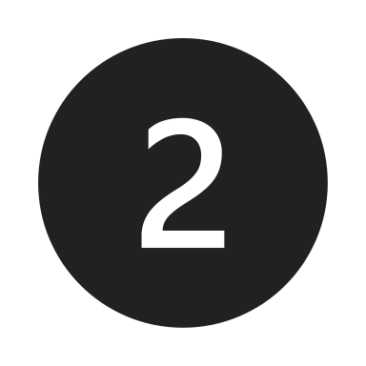
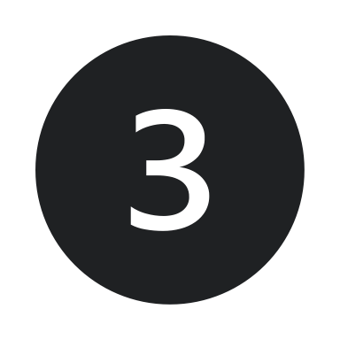
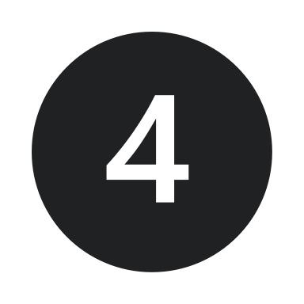
Research Overview
IODA: Host/SSD Co-design for Predictable Storage Stack
SOSP’21
LeapIO: Host/ARM Co-design for Cost-Efficient Storage Stack
Future Work
Notes:
Let's start with IODA, a software/hardware co-design to achieve predictable latencies on modern flash storage.

Slide 14
Unpredictability in SSDs
Host
SSD
Controller
.
.
.
Flash
Flash
Flash
100us
Firmware
.
.
.
PCIe
Flash
Flash
Flash
…
…
.
…
.
Garbage
Collection
.
Flash
Flash
Flash
10ms
100x slower
due to GC
GC is Invisible to the Host
.
.
.
Flash
Flash
Notes:
Modern flash storage is known to suffer from tail latencies. Let’s see why.
(click) SSDs consist of parallel NAND flash chips connected to a controller. The controller runs the firmware to manage all the IOs.
(click) Normal user reads usually takes hundred of micro-seconds.
Due to the lack of in-place over-write support, (click) the firmware runs a log structure and maintains many background processes (such as Garbage Collection) for steady state.
(click) GC migrates data internally across NAND channels and chips to reclaim space, but this causes a lot of internal traffic.
(click) When user reads contend with GC, they will experience a tail latency of 10s of milliseconds,
(click) which is already 100 times worse compared to the normal case.
(click) And due to the black-box nature of existing SSD designs, users don’t know when GCs happen and have no control over them.

Slide 15
Predictability Design Space
State-of-the-Art
IODA: OS/SSD co-design
Direct flash management?
Non-trivial; Incompatible
Application transparency
Flash-aware optimizations?
OS-level policies for predictability
Not aware of SSD internals
Small interface enhancement
An ideal controller design?
Cannot eliminate GC impacts
No major firmware policy changes
Notes:
There are many efforts to tackle this GC-induced tail latency problem across different layers of the stack.
You might wonder why cannot we come up with an ideal controller design? Well, many have explored better scheduling, preemption, isolation schemes and it’s still challenging to eliminate the blocking nature of GC.
Over the years, we have also seen OS-level optimizations, such as flash-aware file systems and driver designs, even so, they cannot see the device internals and can barely help with the unpredictability originated from the device.
Of course, a more aggressive approach to allow the host to directly manage flash, but it’s non-trivial to achieve due to the many constraints of NAND flash media and such changes are incompatible with many applications relying on traditional storage interfaces.
IODA attacks this problem with a co-design approach. IODA doesn't require heavy firmware policy changes. Powered by a small interface enhancement, it gives the OS enough information to cut tail latencies there. And all these changes are transparent to applications, requiring no application code modifications.

Slide 16
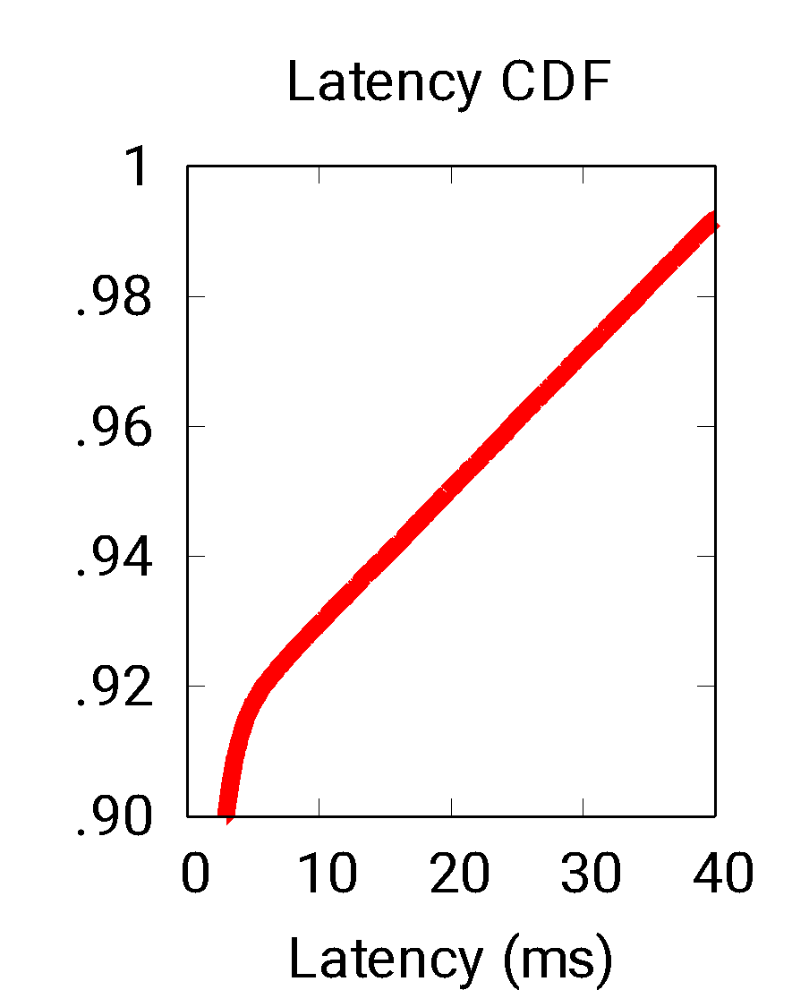
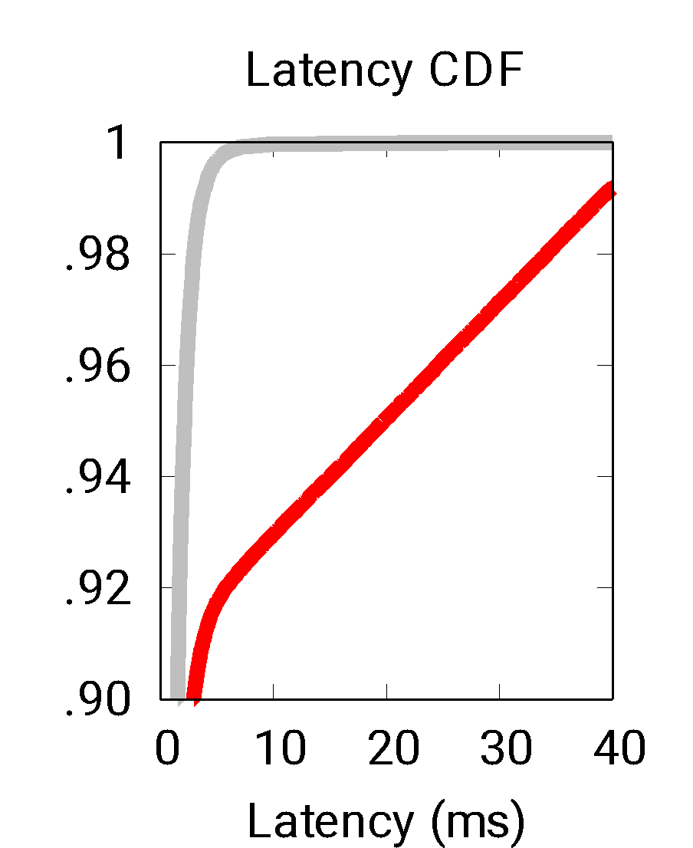
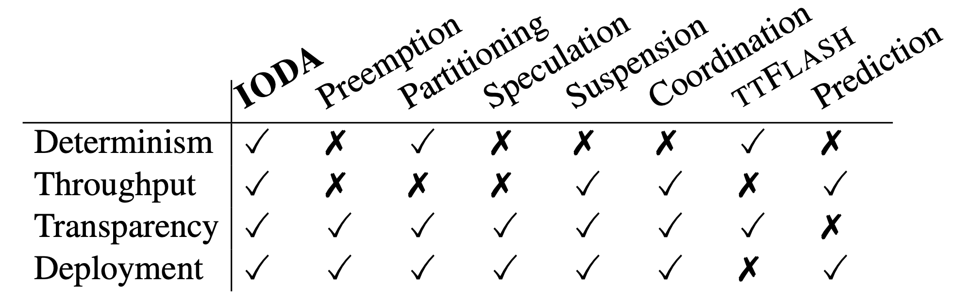
Reality vs. Expectation
Strong predictability guarantees
NoGC (Ideal)
with minimal device-side changes
Room for
improvement
with resource efficiency
GC
without sacrificing throughput
Notes:
IODA is designed with following goals in mind.
First of all, we want strong predictability guarantees at the per-IO level, with an ambitious goals to eliminate all GC impacts.
The figure shows how bad the latency distribution can be under GC. Here, X is latency in ms, and Y is the percentile. We show the latency CDF here. The red line shows that latencies can go wild at high percentiles.
In an ideal case where there is no GC, we can see from the gray line that it's almost straight, showing predictable latencies for all I/Os.
And IODA tries to bridge the gap by pushing the performance towards the NoGC ideal scenario.
Moreover, we don't want to change the device controllers too much since they have gone through years of development by the SSD vendors.
We would also like resource efficiency in terms of both CPU and I/O.
Lastly, unlike many approaches that trade throughput for latencies, IODA sets a more challenging goal to achieve both.
When compared to many state of the art approaches, IODA can achieve performance predictability in an efficient manner, with minimal changes to the flash firmware and interface for easy deployment, without sacrificing throughput.

Slide 17
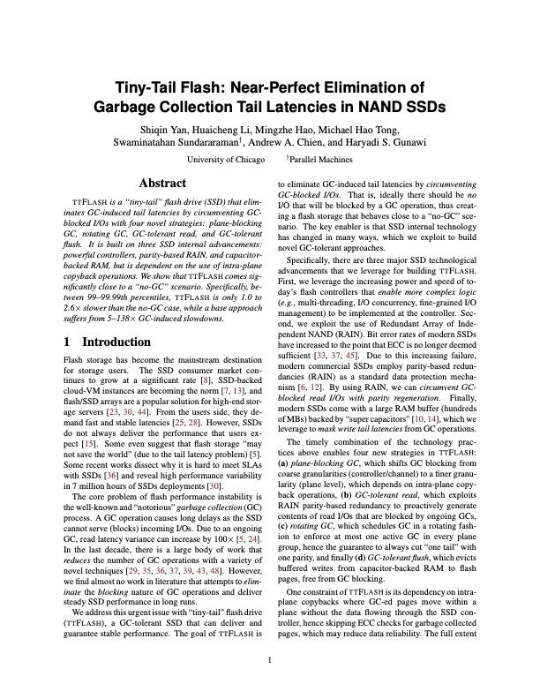
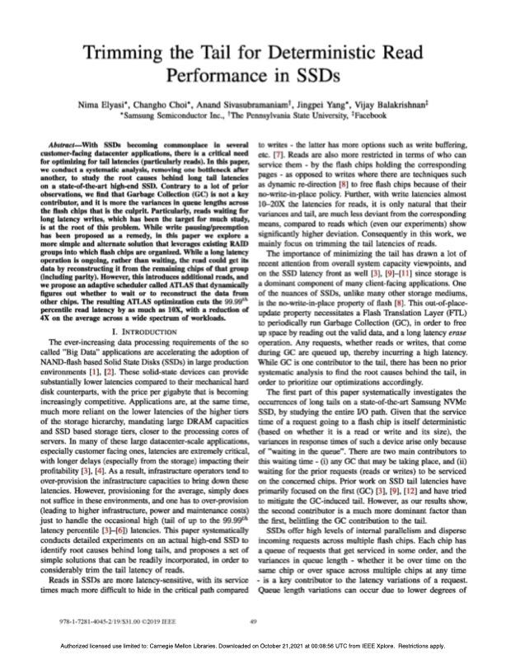
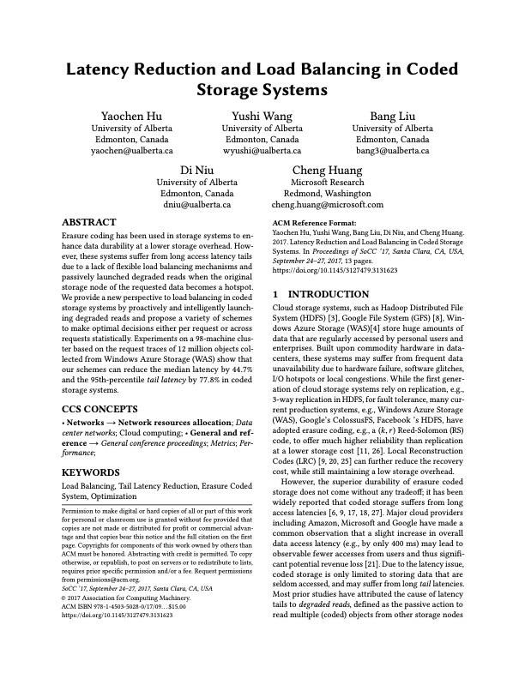
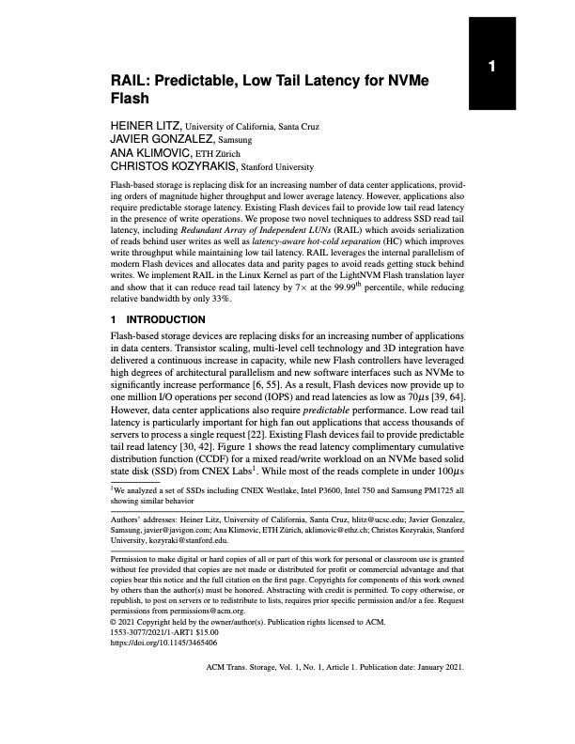
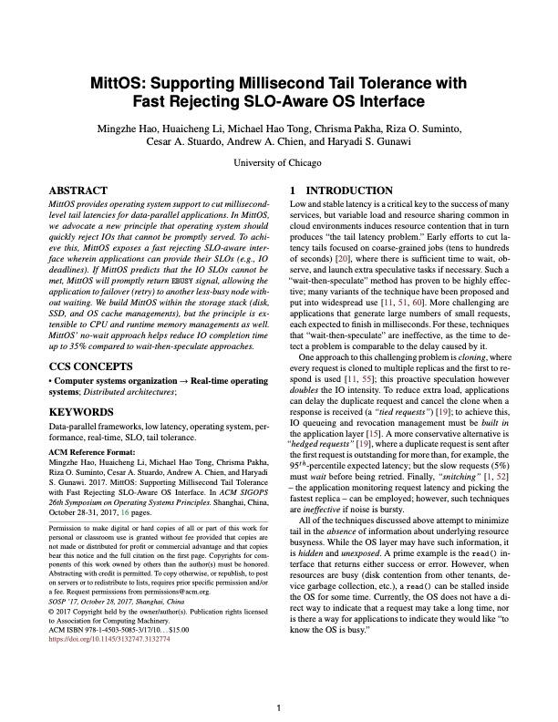
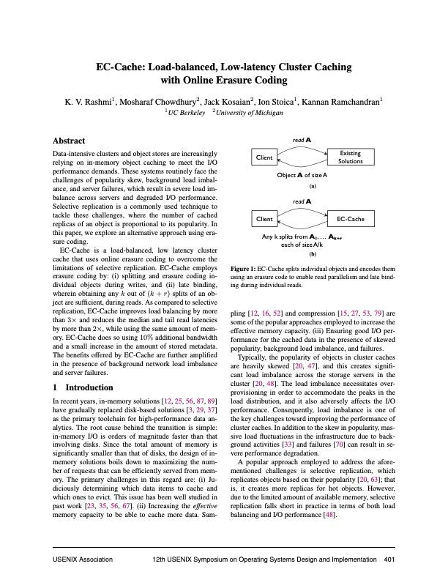
Leverage Redundancy for Performance
An old, effective idea;
Yet, still challenging
When to issue the parity reads?
(1) Wait for timeout
Best threshold? Tricky
(2) Always Proactive (always full-stripe)
Increased load Inefficient
Semantic gap between the Host and SSD to communicate the “busyness”
Notes:
At the bottom, IODA borrows the idea to leverage data redundancy for performance is an old and effective ideal.
(click) As demonstrated by many prior works, it can effectively improve latencies in different scenarios, such as replicas in distributed systems, erasure-coded storage, etc..
For example, we can proactively reconstruct the data from the parity instead of waiting for some slow I/Os.
(click) While the idea is simple and straightforward, there is a major challenge to make it practical: we must address the problem when to exactly issue extra read for proactive reconstructions.
(click) Similar to the speculative execution approach in distributed systems to battle stragglers, here one could choose to wait for a timeout and then perform reconstruction.
(click) However, it’s tricky to pick the correct timeout threshold. Millisecond-level wait is definitely too long for microsecond-level I/O operations.
(click) On the other extreme, if the host always proactively spawns the extra reads.
(click) this will generate unnecessarily more load even when SSDs are not busy.
(click) The semantic gap here is that host and SSDs are not able to communicate about the device-level “busyness”. Thus, existing approaches heavily rely on “guessing”, causing it too lazy or too aggressive.

Slide 18
A Fail-if-Slow Storage Interface
“Fail-if-Slow”: SSDs should fast-fail I/Os contending with GC
Host
flag=true
Fast-Fail
SSD
SSD#2
“Seems your submission
targets a crowded area,
early-rejection!”
early-rejection !
Notes:
First, IODA advocates a new “Fail-if-Slow” SSD interface to bridge the gap. We require the SSD to tell the host whether an I/O will be delayed by GC and fast-fail the affected I/O on purpose.
(click) Here is an illustration.
(click) The host submits requests tagged with a special latency-sensitive flag.
(click) After receiving the submission, the SSD will check whether the user request will be affected by GC or not,
(click) and if so,
(click) fast-fail this request to the host ASAP, without actually executing it.
Upon receiving the fast-failed IO, host side can perform proactive data reconstruction to improve latency.
This way, the host only needs to reconstruct IOs that are known to be slow.

Slide 19


Host
~100us
R
RAID5
xor()
fast-fail
R₀
R₁
R₂
R₂
R₁
R
R
R₃
R₀
100us
SSD#0
SSD#1
SSD#2
SSD#3
~10ms
GC
Notes:
(click) Let’s see how it works in the RAID setup.
(click) Similarly, we submit full stripe reads.
(click) Now SSD 3 is busy with GC. It will quickly fast-fail the sub-IO.
When the host receives the fast-fail signal,
(click) it will proactively send an extra read to the parity SSD.
(click) If the first two SSDs and the parity SSD are not busy, thus after about 100us, these three sub-I/Os will normally return.
(click) With these, we can reconstruct the data of sub-IO R_3 with xor() operations.
(click) After that, the user level read can be safely deemed completed.
(click) This approach has a large performance gain with very small overhead.

Slide 20
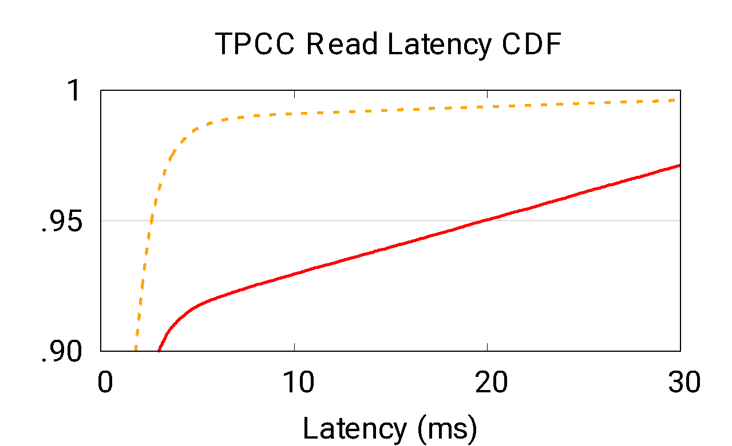
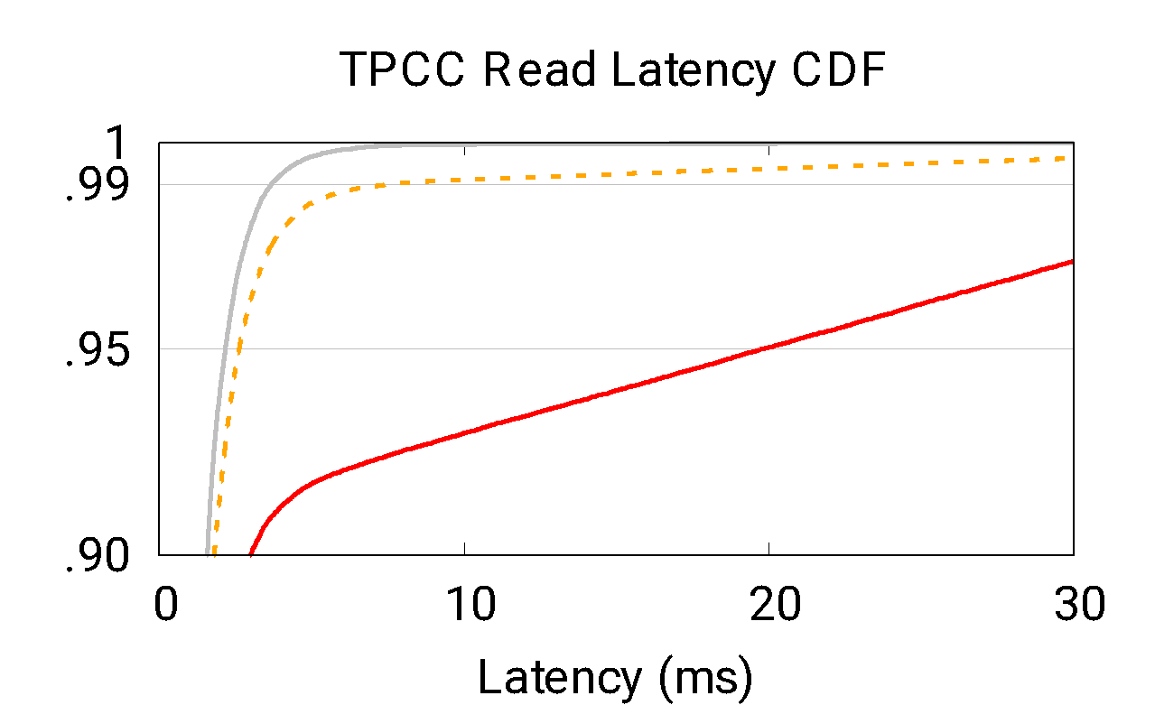
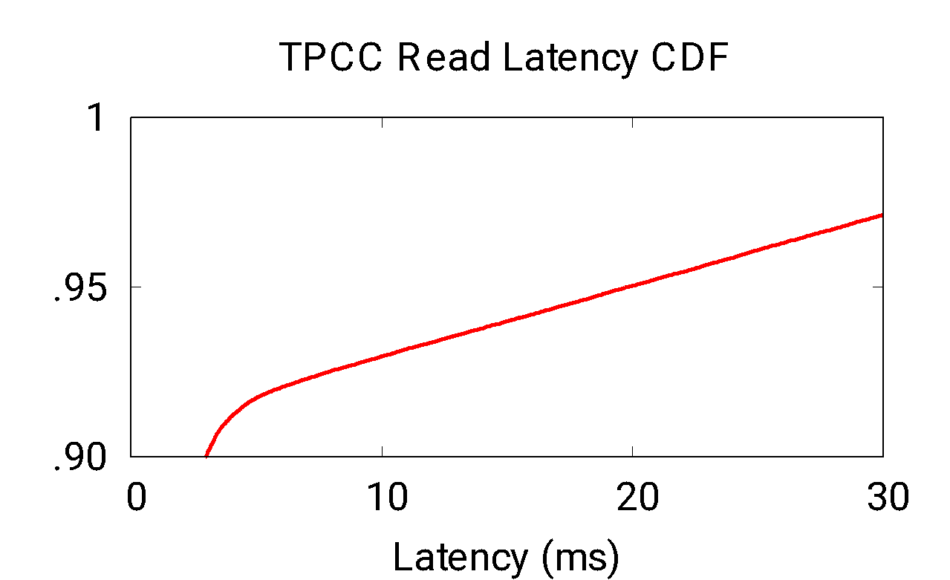
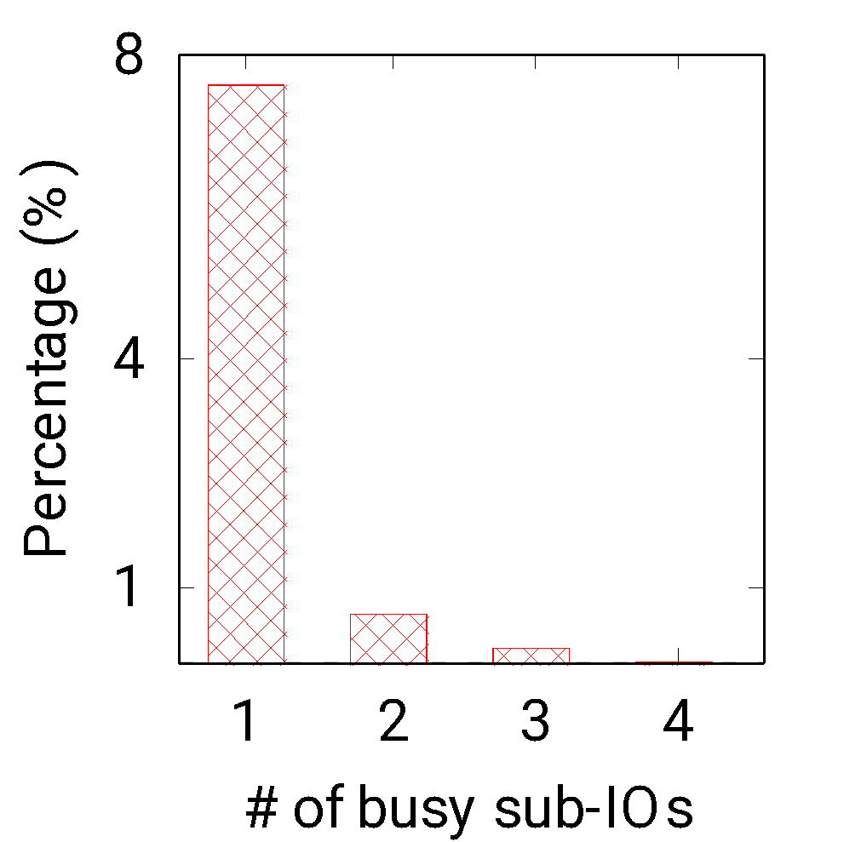
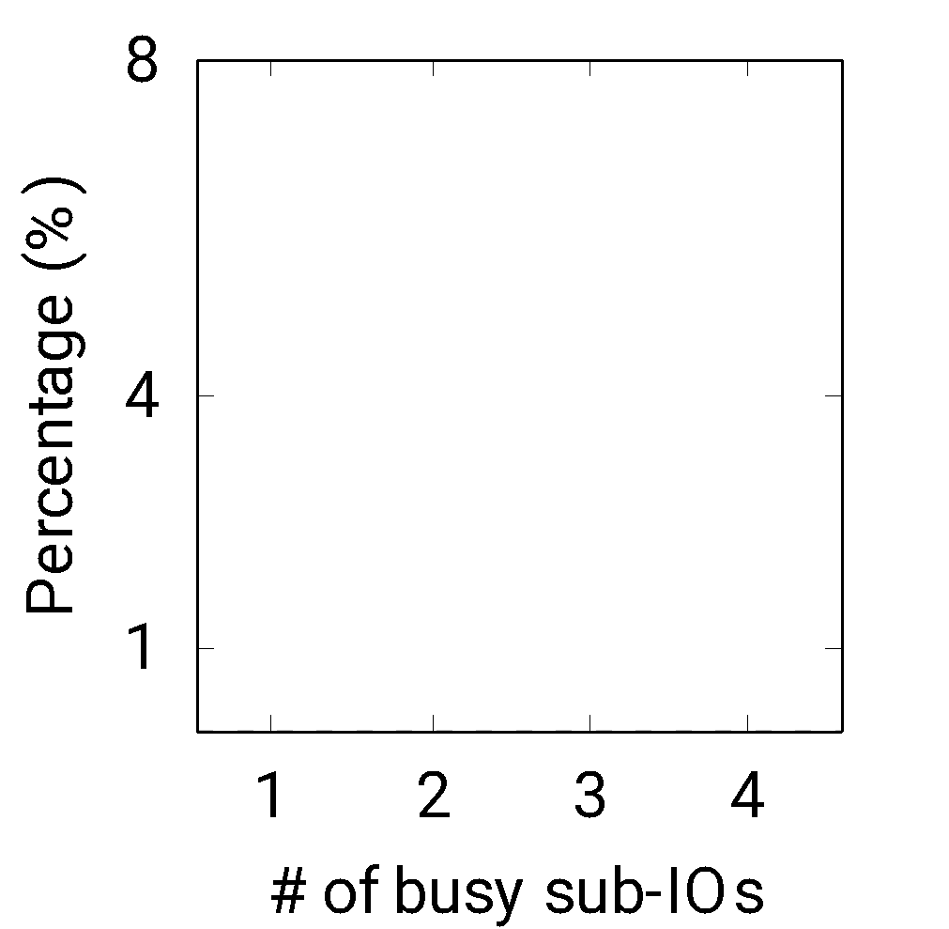
Effectiveness of “Fail-if-Slow” Interface
NoGC
@p99 ~5x
@p95 ~7x
Cut tails up to ~99th percentile
(n, k): “Fast-fail” couldn’t handle >k busy sub-IOs
Notes:
Let’s see how well the new interface works under a TPCC workload. Here, here we show the read latency CDF. The red line is the base case.
(click) We can see that the dotted orange line improves tail latency a lot.
(click) For instance, We get roughly 7 times better latency at 95th percentile,
(click) and 5 times at 99th percentile.
(click) Overall, the fast-fail interface helps cut tails up to 99th percentile.
You may wonder why 99? Let’s measure one level deeper.
(click) On the right, we plot the percentage of reads being blocked by different # of busy SSDs.
(click) For example, if x=2, the bar represents percentage of user I/Os experiencing two concurrent-GCs.
(click) We observe that fail-fast interface can only help with I/Os experiencing 1 busy SSD.
(click) Thus, we still see a gap towards the NoGC idea case performance.
(click) In general, given k parity blocks associated with n data blocks, we can only tolerate k busy sub-IOs.

Slide 21
The Case Against Proactive Reconstruction
Host
Semantic Gap: the host doesn’t know how long
SSD “busyness” will last
R
RAID5
✘
xor()
R₀
R₁
R₂
R₁
R
R₃
R₀
fast-fail
End up waiting for
the busiest SSD
SSD
#0
SSD
#1
SSD#2
SSD#3
GC
GC
Notes:
Let’s take a closer look at why proactive reconstruction doesn’t work under concurrent GCs.
(click) When two SSDs are bus
we might see one of the first fast-failed sub-IO trying to triggering the parity reconstruction.
But this time reconstruction won’t be fast because the parity read to SSD#2 is slow as well. Similarly, if 3 or more SSDs are all slow, it couldn’t help either.
A better and intuitive solution is to choose to wait for the less busy SSDs and we could still save some latency by doing reconstructions.
(click) But the problem here is that we don’t know how long the “busyness” will last, thus
(click) a random wait approach might end up waiting for the busier SSDs with longer tails.

Slide 22

Busy Remaining Time (BRT) Exposure
“Fail-if-Slow”: the SSD should fast-fail an I/O if it contends with GC
Piggyback BRT to reconstruct data from less busy SSDs
Host
flag=true
“BRT: 10ms”
Fast-Fail
SSD
Notes:
To handle this, IODA extends the interface a bit more to communicate the device busyness. In particular,
the SSD knows exactly how long an IO will be delayed by GC. Then, in the fast-fail process,
(click) along with the busy signal, we also piggyback the busy remaining time to the host. After the host collects enough information about all busy SSDs, it can force the read to wait for the less busy SSD and performance reconstruction. This way, we could still save some latencies by waiting for the less busy devices.

Slide 23
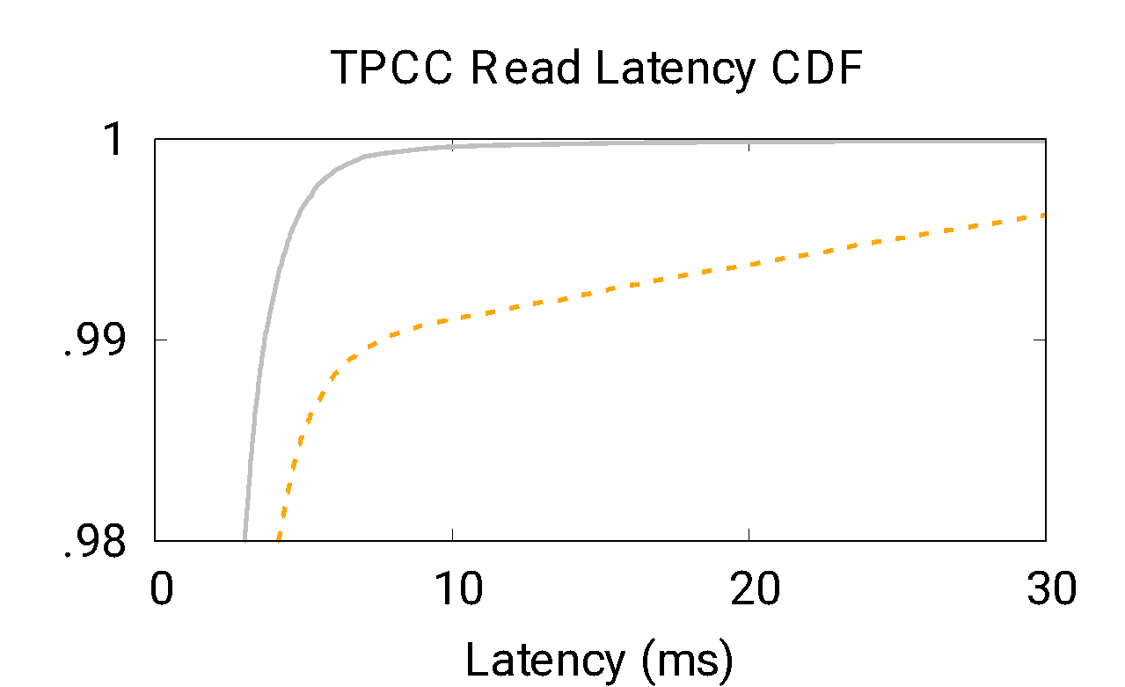
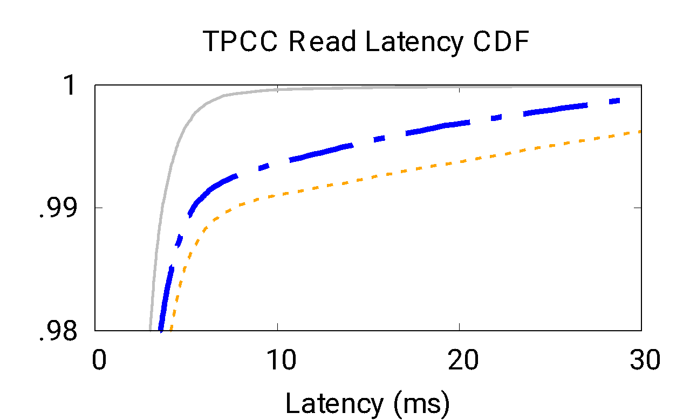

Effectiveness of the “BRT” Interface
BRT helps a little
Can we do better?
Notes:
(click) Here is the result of the busy remaining time interface.
(click) Well, it further helps compared to previous technique.
(click) It shifts the line to the upper-left a little bit,
(click) but tails are still there, as shown by the shaded area! The reason is that we still have to wait for at least one GC to complete. When the concurrent GCs tend to be busy for similar amount of time, this approach won’t work either.
(click) So can we do better to push closer towards the ideal NoGC performance?

Slide 24
Busy Latency Windows
“Fail-if-Slow”: the SSD should fast-fail an I/O if it contends with GC
Time Window (TW) Coordination: SSDs take turns to perform GCs
Always
Predictable Latencies!
SSD#3
GC
SSD#2
GC
How long
should TW be?
SSD#1
GC
SSD#0
GC
t
t+TW
t+2xTW
t+3xTW
t+4xTW
Notes:
To ensure proactive reconstruction will always be fast, we need to create a case with at most 1 busy SSD at any time. Is it possible? Well, the answer is yes!
(click) We can schedule the SSDs in the same array to perform background operations in different time windows.
(click) Thus reconstruction is guaranteed to work. Each SSD can stick to its own time window in an autonomous manner, thus minimal coordination across SSDs.
(click) One more thing to worry about is the safe time window length. Image an extreme case where you set an infinitely-long time window, you are essentially preventing GCs from kicking in for the other SSDs, thus they will bare the risk of running out of space!

Slide 25
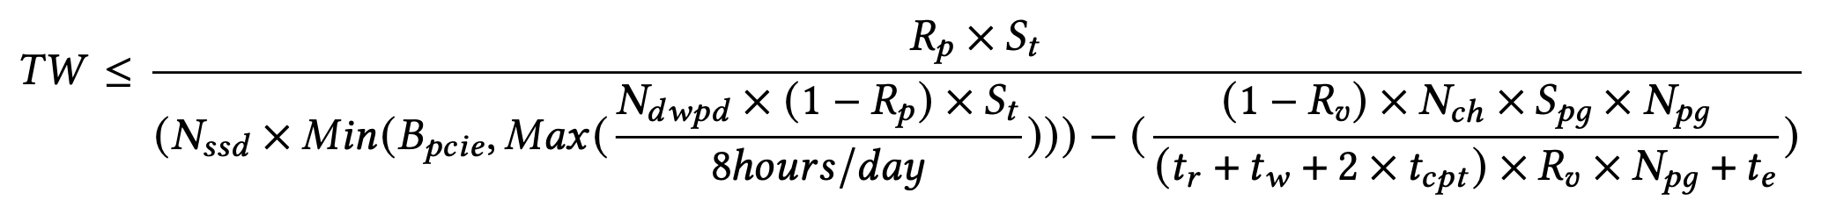
Time Window (TW) Formulation
B_{burst} : User load
SSD free space >= User load
SSD
GC
t
t+TW
t+2xTW
t+3xTW
t+4xTW
B_{gc} : GC reclamation speed
S_{p}
: Over-provisioning space
TW Upper Bound
Notes:
Therefore, time window shouldn’t be too long.
(click) Thus, the ideal case is that at any time point, we should have enough free space in the SSD to absorb incoming write traffic.
(click) Let’s consider the general case.
(click) We might have user writes keep coming for all the time windows,
(click) while one SSD is only allowed to perform GC in a certain time window.
(click) With this, we can formulate the time windows constraints,
(click) which can be further expanded as this formula, giving us an upper bound value. The vendors could refer to the controller parameters and NAND spec sheet to program the appropriate window length.

Slide 26
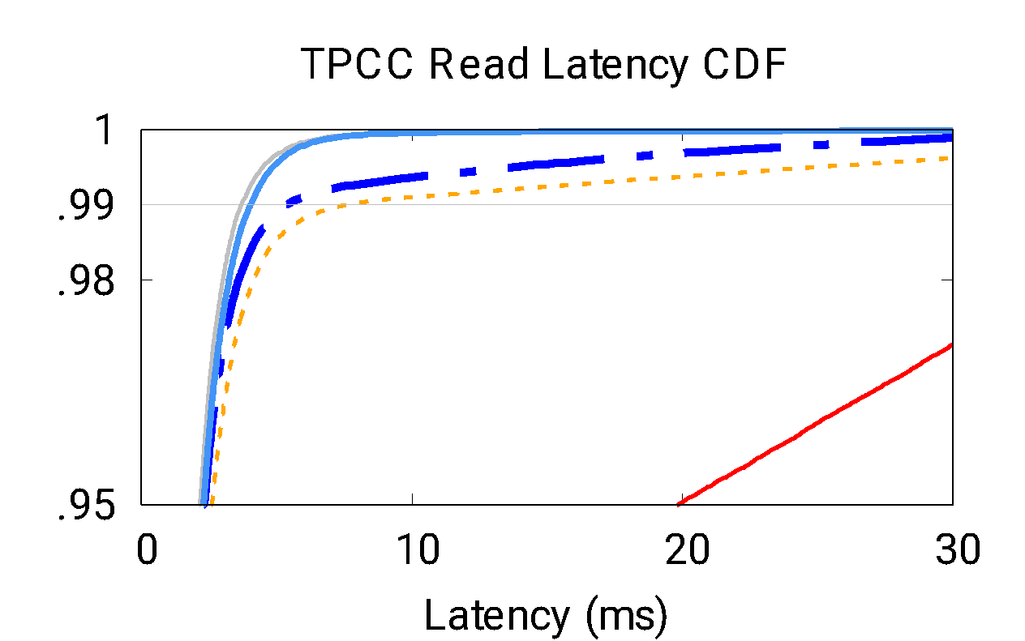

No Tails!
IODA closes the gap between Base and NoGC
Notes:
With all these combined, we can see that the IODA line is almost overlapping with the gray NoGC line,
(click) showing that IODA has NO TAILS.
(click) And IODA really closes the gap between the baseline and NoGC.

Slide 27
Design Space Enabled by the Fast-Fail Interface
Performance predictability vs. NAND Flash lifetime
Dynamic TW management
Applications to different scenarios
Parity: RAID-4/6, Erasure Coding, Replicas …
Context: Non-volatile Memory, Networking Card, OS, etc.
Tail sources: queueing, resource contention, etc.
OS
Move up performance-critical management to software
Co-design
Hardware

Slide 28


IODA Takeaways
A co-design approach for performance predictability
Proactive reconstruction via fast-fail interface
BRT for improved latencies
TW formulation to program the window length
Cross-device coordination
“Small but powerful”!
Host
SSD
SSD
SSD
Notes:
In summary, IODA is a host/SSD co-design to bridge the semantic gap for performance predictability. Powered by a simple fast-fail interface, it could perform timely reconstructions with synchronized time windows across SSDs. IODA only involves small changes to the software and hardware stack for easy deployment.
In principle, IODA advocates co-designs (click) not only between host and SSD, (click) but also among SSDs to achieve tail-free performance

Slide 29
Research Overview
IODA: Host/SSD Co-design for Predictable Storage Stack
LeapIO: Host/ARM Co-design for Cost-Efficient Storage Stack
ASPLOS’20
Future Work
Notes:
IODA gives us low and preditable latencies.

Slide 30




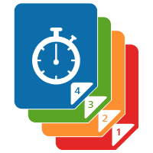

The Heavy Cloud Storage Tax
Storage
services
VM
VM
VM
Cloud
server
...
...
x86
x86
x86
x86
x86
x86
x86
x86
x86
Deep Storage Stack
Device
management
Context Switches
10-20% of CPU cycles burnt only for storage stack
Polling/Interrupts
SSD
SSD
SSD
Notes:
Today’s cloud storage stack is very complex and imposes a heavy operational cost.
(click) The servers in data centers provide a large array of x86 cores.
(click) In part, most of the CPUs are rent to the users, and they are used to run various types of user workloads, such as NoSQL Databases, Analytics, and ML. (click) Cloud providers charge users for the amount of computational resources used, proportional to number of cores. Thus, making revenue.
However, the storage stack takes away some previous cores.
(click) On the one hand, many storage services requires a lot of CPU resources to run;
(click) on the other hand, device management also incurs a lot of CPU overhead.
(click) All these form the cloud storage tax.
(click) As a result, about 10-20% of data center CPU cycles are spent to run storage stack only. This is a heavy data center tax that cloud providers have to pay!

Slide 31
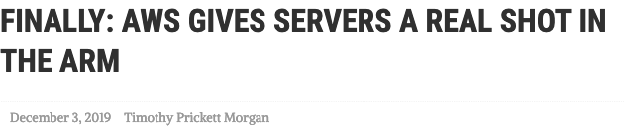
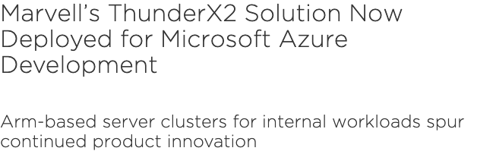
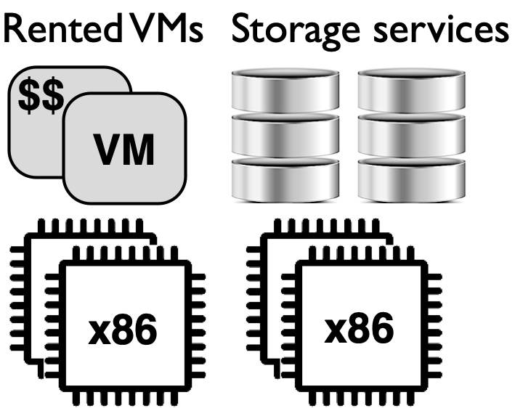
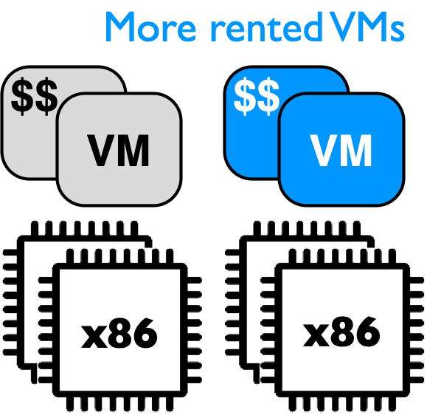
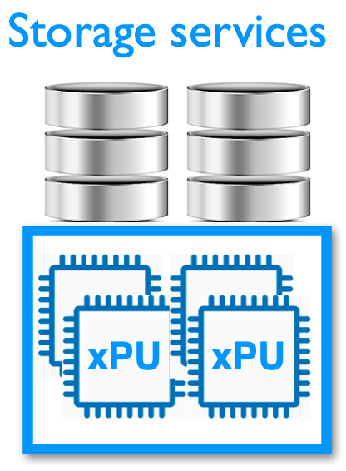

Offloading for Cost-Efficiency
ARM SoC TCO: $100/year
x86 for VMs: $2000/year
~20x Cost Savings
+
Notes:
Ideally, CPUs are better spent to run user workloads for revenue.
(click) With the rise of accelerators, a straightforward solution is to offload the storage services to cost-efficient co-processors.
(click) The first question to ask is which acceleration hardware we should use? And how much cost-efficiency it will bring?
(click) We observe that ARM co-processors are being increasingly deployed in modern data centers, for example, Azure already deployed ARM servers for their internal workloads,
(click) and AWS is doing something similar. This motivates us to look into ARM co-processor as the appropriate offloading engines.
(click) Cost-efficiency perspective, the total cost of ownership of an ARM SoC is only about $100 per year, but the saved host CPU cores could potentially make $2000 / year by renting them to users.
(click) Overall, we can achieve roughly 20x cost savings and this would definitely increase cost-efficiency of the cloud storage offering.

Slide 32



LeapIO Overview
Cloud storage stack offload-ready to ARM co-processors
VM
VM
VM
VM
VM
VM
Storage Services
Storage Services
PCIe
x86
x86
x86
ARM
Device Management
Device Management
SSD
SSD
SSD
SSD
SSD
SSD
x86
Notes:
LeapIO is a next-generation cloud storage stack that leverages ARM SoC as co-processors.
(click) Traditional storage stack centers around CPUs to provider virtual storage to users and manage SSDs, similar to AWS EBS, it provides a virtual block device to user VMs.
(click) At high level, LeapIO shares similar goals. LeapIO allows storage services to portably run ARM coprocessors and x86 with a uniform abstraction. LeapIO helps cloud providers cut the storage tax and improve utilization without sacrificing performance.

Slide 33

LeapIO Architecture
NVMe QP Mapping
ARM
Storage
Services
SSD
F( )
Replication
SSD
User
Priority Scheduling
VM
Design benefits:
OS
+ Extensibility
x86
SSD
+ Performance
+ Composability
PCIe
: NVMe Queue Pair (QP)
Notes:
Let's see how LeapIO works by going through a simple example first. In LeapIO, users run their own application and guest OS of choice on a VM with no modifications required.
(click) For storage, the guest VM runs on the typical NVMe device interface exposed by LeapIO as an NVMe queue pair.
(click) The queue pair contains submission and completion queues for regular IO processing.
(click) To process IOs from the VM, LeapIO maps the queue pair from the VM to its own address space.
If the user VM wants to utilize local SSDs, say, for throughput and latency reasons,
(click) the requests will be put into the NVMe queue pairs mapped between the LeapIO runtime and the SSD device.
(click) The shaded area represents the LeapIO runtime running on the ARM co-processors in userspace.
(click) The runtime "glues" all the NVMe queue pairs and form end-to-end storage paths.
(click) This runtime enables us to run arbitrary storage services that simply operate using NVMe interface, as simple as a chain of NVMe commands.
(click) This design gives us some benefits: (1). the first one is service extensibility. LeapIO runtime allows cloud providers to easily build and manage many different storage services. Second, the runtime keeps polling the mapped NVMe queue pairs to maintain low latency and high throughput; The LeapIO runtime does not reside in the OS, hence all data transfers can bypass the OS; Third, VMs can obtain a rich set of block-oriented services behind the virtual NVMe interface, thus enabling service virtualization and composability.
(click) For example, IOs from different VMs might have different priorities and a priority scheduling service will decide when an IO will be processed and after that send IOs to the device.
(click) With another service feature such as reliability guarantee, the IOs will be further processed via a "replication" service and
(click) finally sent to different backend devices.

Slide 34

The Need for Portability
1st Generation
2nd Generation
3rd Generation
TCP
RDMA
RDMA
x86
x86
x86
ARM
SSD
SSD
SSD
Avoid fragmenting the server fleet into silos defined by
hardware capabilities and specific software optimizations
Notes:
One design challenge of LeapIO is portability. The server configurations in modern data centers are never uniform. Different server generations have different capabilities.
(click) For example, an old server model might not have acceleration co-processors or high performance RDMA NIC. But as time goes on,
(click) these components will be increasingly added to the server fleet.
(click) With portability,
(click) we try to avoid fragmenting the fleet into silos defined by the hardware capabilities and specific software optimizations.
Thus, LeapIO could serve as a uniform software environment which can support running on different hardware setups.

Slide 35
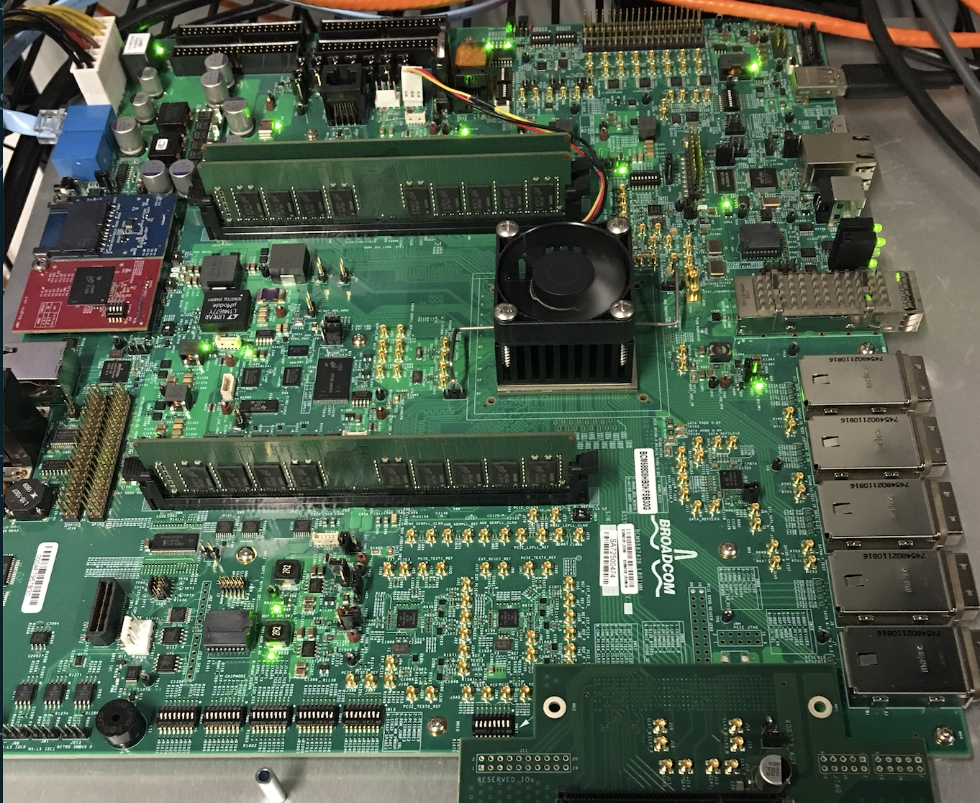
LeapIO Portability
User VM
SoC
“SoC”-in-VM
ARM
x86
RDMA
REST
TCP
PCIe
HDD
SSD
OpenChannel-SSD
Treat hardware acceleration as an opportunity instead of a necessity
PCIe
Notes:
In LeapIO, the storage software stack is portable to run on x86 or in the SoC whenever available, thus an offload ready design. The user VMs are agnostic to what is implementing the virtual drive.
(click) To support LeapIO to run on x86, we design a SoC-like-VM such that the overall design remains the same as in ARM-SoC. We argument the SoC-VM with global resource visibility and it sees the same abstraction as ARM SoC.
(click) With LeapIO’s portability design, we keep servers fungible regardless of their acceleration or offloading capabilities. That is, we treat accelerators as opportunities rather than necessities.
(click) With this, we could access backend storage devices through different types of protocols, via PCIe for local access or RDMA, TCP and REST APIs for remote storage access.
With the virtual NVMe abstraction, LeapIO is also able to work with different types of devices, whether it is slow HDD or SATA based SSD, or emerging software-defined flash.
Moreover, portability also helps provisioning; if the SoC is crowded, we can ask for help from the SoC-VM.

Slide 36

LeapIO Efficient Data Path
Storage
Functions
ARM
F( )
No direct ARM-x86 communication
User
Data copies across address spaces
VM
OS
x86
ARM
SSD
Unified
Address
Space
SSD
x86
PCIe
Zero Copy
Notes:
It’s ialso mportant to achieve bare-metal performance.
(click) The problem is that in existing ARM SoC designs, ARM cores are hidden behind either the NIC controller or storage interface, thus ARM-x86 communication must be routed through NIC/storage control block and not efficient.
(click) Furthermore, many software/hardware components are involved in the data path, hence we must minimize data copying. While there is only one copy of the original data, different hardware components and software layers need to access the data in their own address spaces.
(click) To minimize data copies, we design a unified address space which incorporate x86, ARM, SSDs and NICs, supported by memory mapping across several address spaces via a transparent address translation support.

Slide 37
ARM SoC Design Inefficiencies
DMA
DRAM
ARM
P2P DMA
PCIe
MMU
access
x86
SSD
DMA: Direct Memory Access
MMU: Memory Management Unit
P2P: PCIe Peer to Peer
Notes:
However, easy offloading of services to the co-processor while maintaining performance cannot be achieved without hardware support.
Thus, we define and design a set of hardware properties to make ARM-to-peripheral communications as efficient as x86-to-peripherals.
(click) First, ARM SoC needs to have a native DMA engine to allow ARM directly talk to host DRAM and must allow the user-space LeapIO runtime to access the DMA engine to queue pair mapping and data transfer.
(click) Second, the LeapIO runtime must have access to an IOMMU to translate VM-level IO addresses.
(click) Third, the co-processor DRAM must be visible by the RDMA NIC and SSD for peer-to-peer DMA. For this, the SoC must expose its DRAM space as a memory region on PCIe to the x86 host.

Slide 38
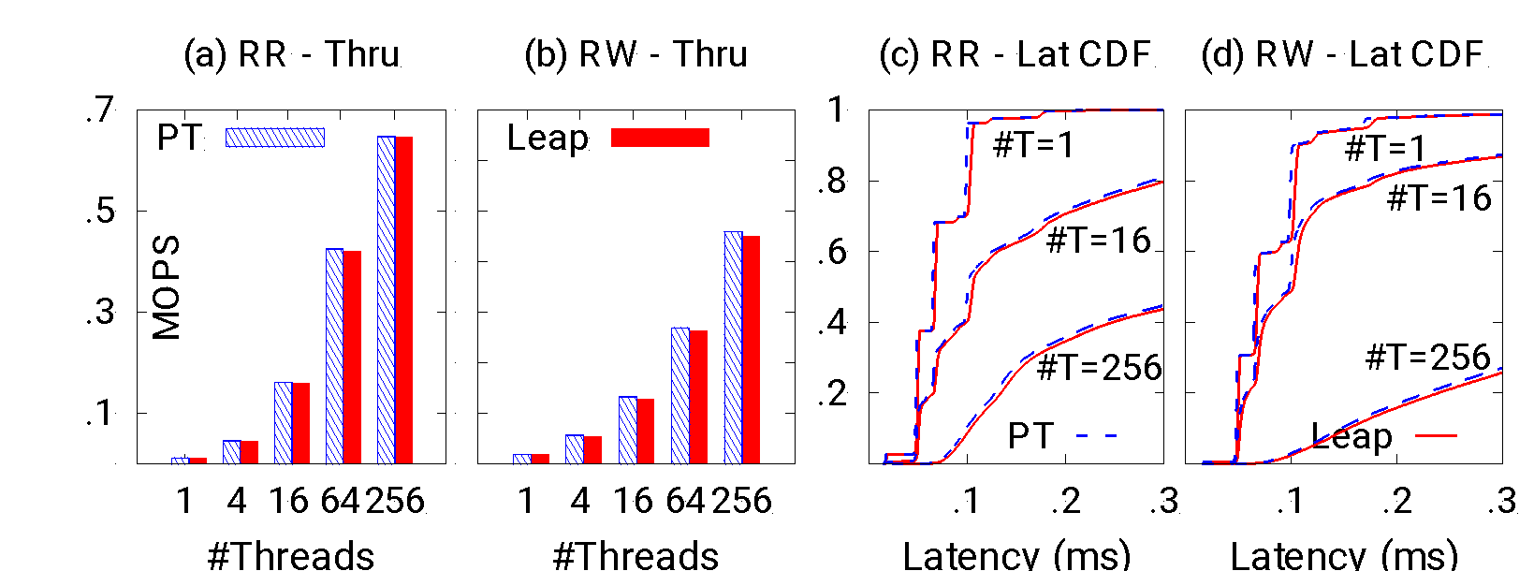
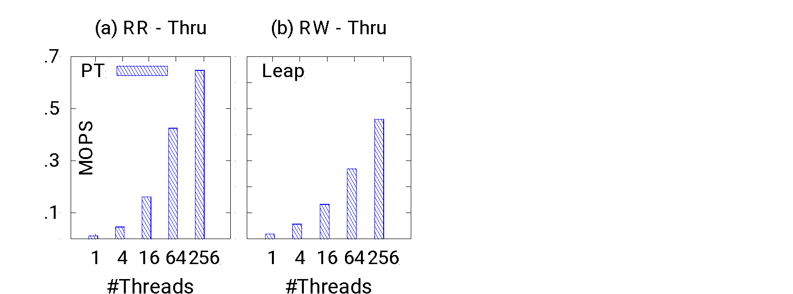
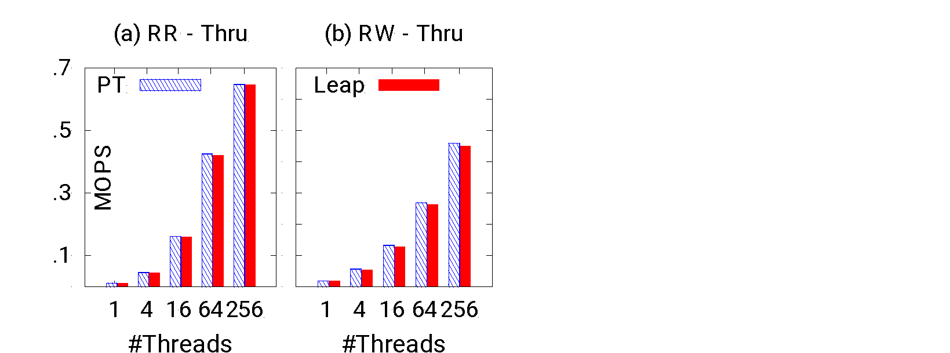
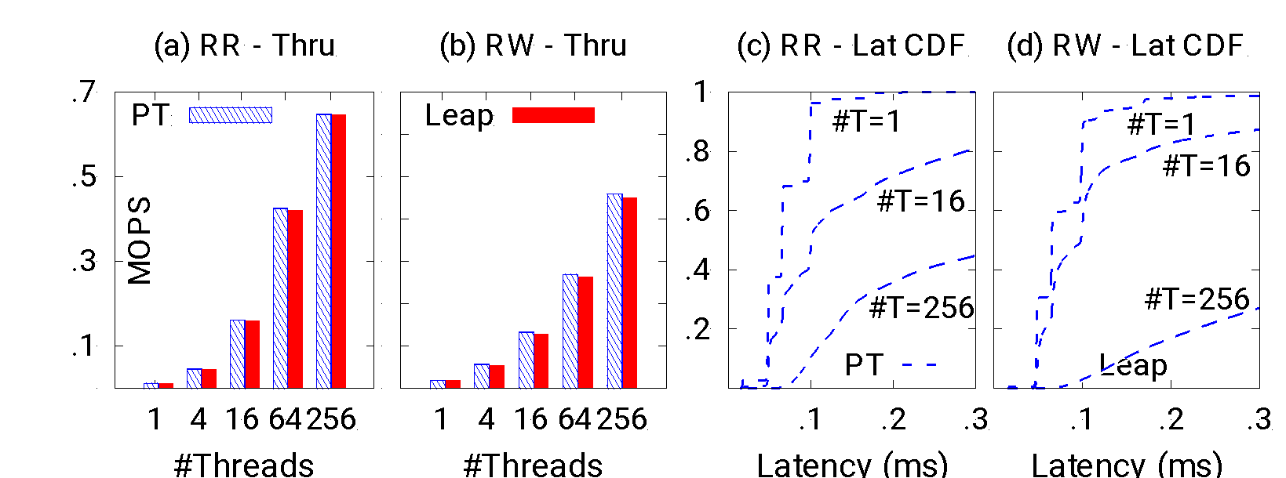
LeapIO Software Overhead (“SoC”-VM)
No Tails
LeapIO
FIO
User
VM
Host
Linux
Low Overhead: 2-5%
“SoC”
VM
Notes:
We first evaluate LeapIO’s software overhead using a SoC-VM setup. On top of a Linux machine, we run LeapIO stack in the SoC-like VM, and expose a virtual NVMe drive to another user VM, backed by datacenter-SSD.
(click) The user VM run regular file IO benchmark on top of the virtual NVMe drive.
(click) We ran two different types of workloads: rand-read and read mixed with writes.
(click) Here, X-axis represents # of IO threads used, (click) and Y represents performance numbers in Millions of IOs per second. The blue bars represent the bare metal performance under a device pass-through.
(click) With LeapIO, we observe that it’s able to achieve (click) similar scalability with increasing number of threads at minimal IOPS drops.
(click) On the right, we show the latency CDFs. (click) And similarly, LeapIO stack is able to deliver close-to-bare-metal latencies without introducing extra tails.
(click) Overall, LeapIO software stack imposes a very low overhead at 2 to 5 percent.

Slide 39
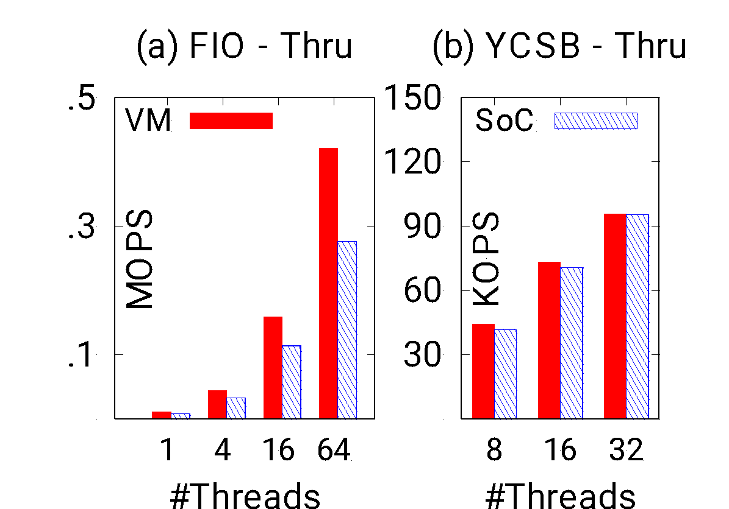
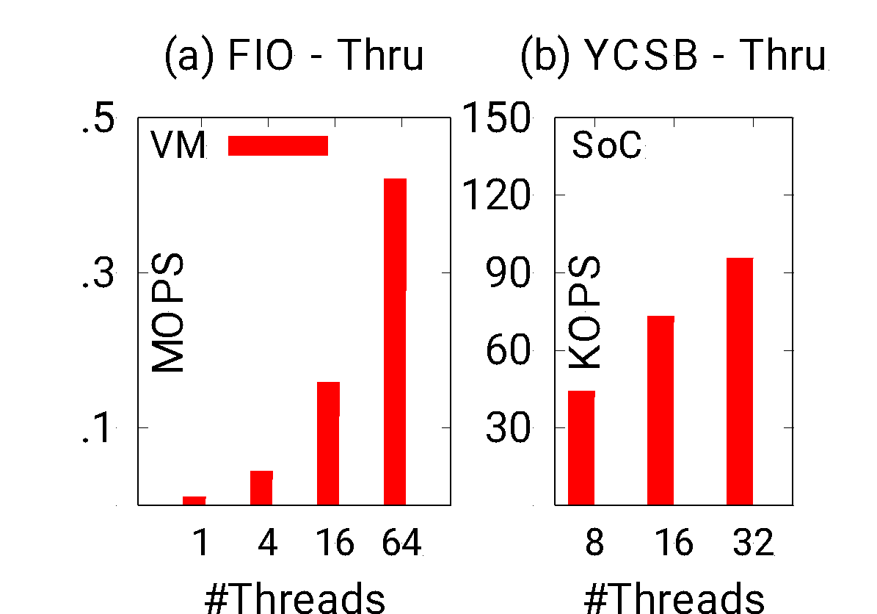
LeapIO Performance on ARM SoC
30% Overhead due to ARM SoC Inefficiencies;
Will improve with future ARM SoC Designs
Notes:
Furthermore, we run a similar experiment, but this time with LeapIO running on a ARM SoC. We run FIO and YCSB workloads and show the throughput.
(click) Due to current ARM SoC design inefficiencies, we see a up-to 30% throughput drop. However, we believe that the performance will significantly improve with future ARM SoC designs when all necessary hardware features are achieved.

Slide 40
LeapIO Summary
End-to-end offload-ready cloud storage stack
Portability
Extensibility
Efficiency
Composability
20x TCO benefits
2-5% software overhead (30% on ARM SoC)
Implications for vendors to bridge the gap between ARM and x86
Notes:
[todo] Need rework on this .. Talk about high-level takeaways, design principles, how does it correlate to the high-level research theme/thrust? How general is this design?
In summary, LeapIO is an end-to-end offload-ready cloud storage stack design which achieve portability, extensibility, efficiency and many other deployment features.
(click) It brings 20 times cost savings at only 2-5% software overhead.
(click) We also suggest to SoC vendor with several hardware properties to bridge the performance gap between ARM and x86.
(click) I’m also very happy to share with you that LeapIO is being deployed in Microsoft data centers to serve production workloads.

Slide 41
Research Overview
IODA: Host/SSD Co-design for Predictable Latencies
LeapIO: Host/ARM Co-design for Cost-Efficiency
Future Work
Notes:
Let's start with IODA, a software/hardware co-design to achieve predictable latencies on modern flash storage.

Slide 42
Future Systems Research is Exciting!
Fail-Slow [FAST’18]
Future
Research
How should OS/Storage evolve to better support emerging applications?
[Systems specialization, Near-data processing]
Application
Analytics
KV
ML
Serverless
MittOS [SOSP’17]
OS
IODA
[SOSP’21]
SamSung
What new OS abstractions are needed
for emerging hardware?
[Programmability, Performance]
SSD
ARM SoC
SmartSSD
FPGA
NGD
ttFlash [FAST’17]
LeapIO
[ASPLOS’20]
ZNS
ARM
ScaleFlux
CMB
FEMU [FAST’18]
CXL
MIPS
Eideticom
PMR
Broadcom
ZNS
KV
Optane DIMM
Optane SSD
Mellanox
Notes:
Looking forward. I believe we can push the co-design to the next level for both emerging hardware and applications.
Nowadays hardware are evolving quickly.
(click) Many flash storage hardware keep springing up that remain to be explored on how they could be integrated into existing system designs.
(click) We also see a new brand of “smart” devices,
(click) which are coupled with different flavors of computation power or storage formats.
(click) And behind these, many vendors are working on different directions.
(click) So one timely direction for future research is to build new proper abstractions for these emerging hardware so that hardware-promised benefits can be easily exposed to the applications, in terms of both performance and easy-programmability.
(click) On the application side, several important categories of applications listed here are taking up major CPU cycles in modern data centers, similar to the hardware specialization trends, (click) I think it’s time to rethink specializing existing OS/Storage designs to better support these application types.

Slide 43
Core Systems Research
ML
Database
OS/Storage
[Now]
Networking
Architecture
Interdisciplinary: Systems + X
[Future]
Notes:
While my current work focuses on core systems research,
(click) I envision my future research to be interdisciplinary.
Actually one benefit to hire a system person like me is
(click) the broad collaboration opportunities that systems research can bring.
(click) More specifically, systems research can greatly benefit from approaches from other area, as well as serving as key technologies and driving force to tackle problems in other domains,
such as machine learning, database, computer networking and architecture.
While my current work focuses on core systems research,
(click) I envision my future research to be interdisciplinary.
(click) Systems research enables broad collaboration opportunities. Systems research can benefit from approaches from other area, as well as serving as key technologies to solve pain point problems in other domains,
(click) such as machine learning, database, computer networking and architecture. I look forward to collaborating with many of you at HKUST.

Slide 44

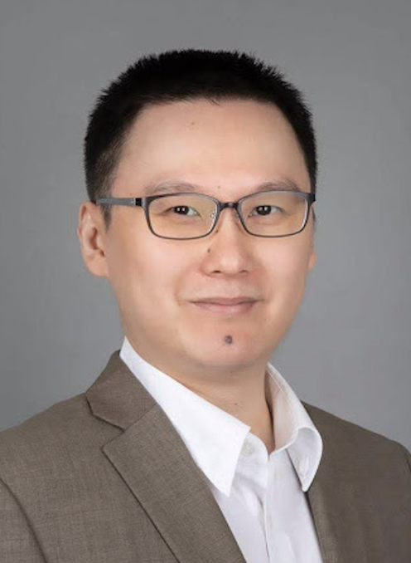


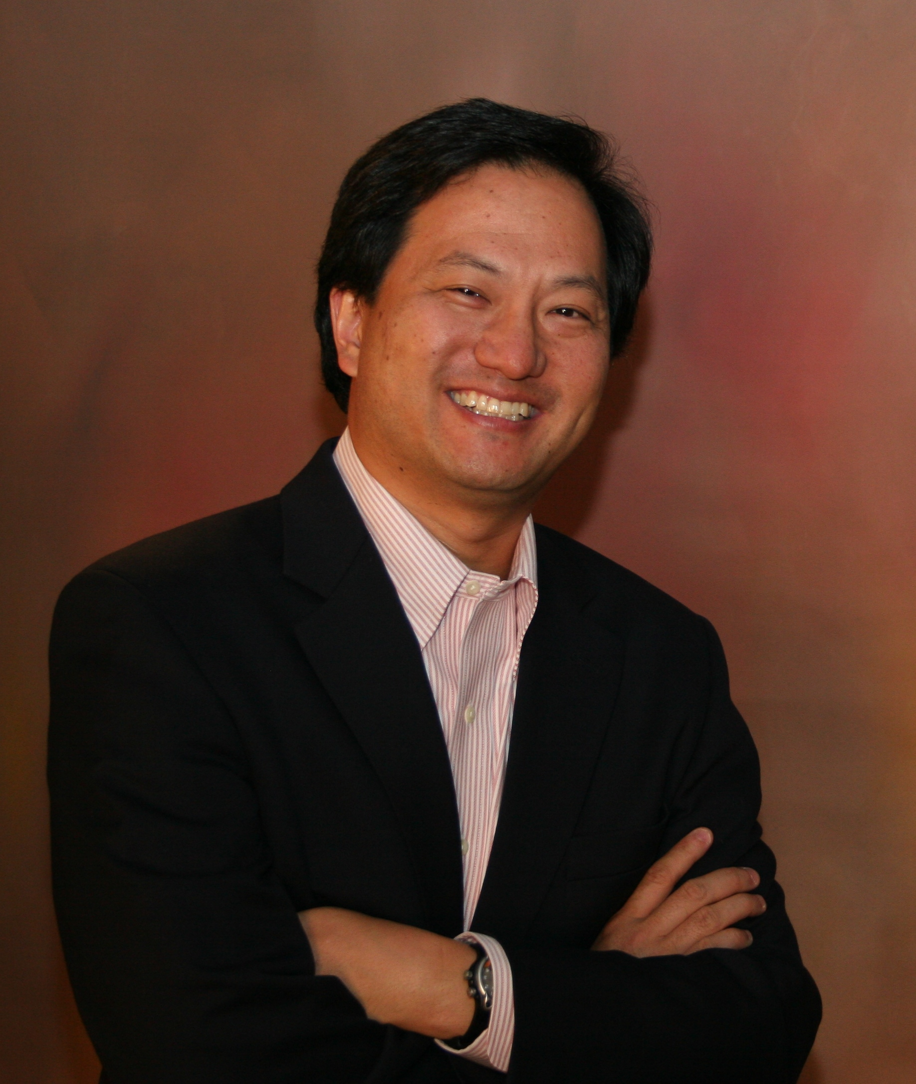

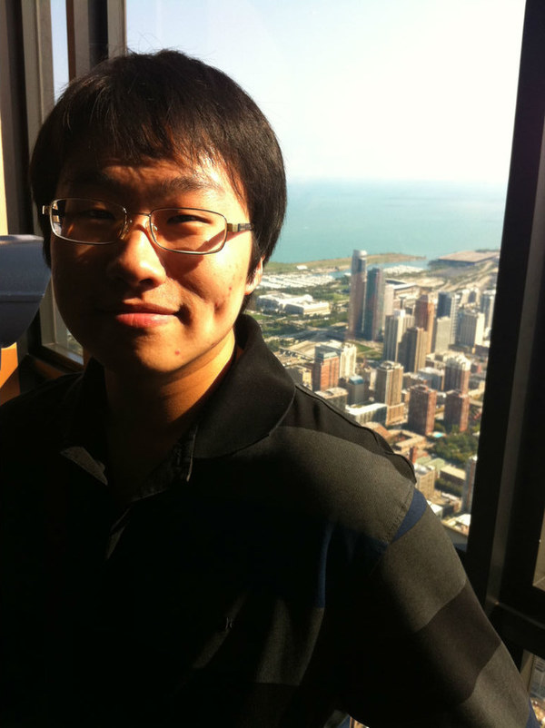
















Haryadi Gunawi
Greg Ganger
George Amvrosiadis
Andrew Chien
Colleagues and students at Univ. of Chicago and CMU
Microsoft Research, Western Digital, NetApp, …
Notes:
[todo: Add colleagues at Univ. of Chicago]
Before ending, I would like to use this opportunity to express gratitude to my advisors and collaborators at University of Chicago and CMU
(click) my mentors and collaborators at Microsoft Research, Western Digital, NetApp and Samsung;
(click) as well as my current and past students. Without them these work couldn’t have been made possible.

Slide 45
Co-design for Better Performance and Efficiency
Fail-Slow [FAST’18]
Future
Research
Application
Analytics
NoSQL
ML
Serverless
MittOS [SOSP’17]
Thank you! Questions?
OS
IODA
[SOSP’21]
SSD
ARM SoC
SmartSSD
ttFlash [FAST’17]
LeapIO
[ASPLOS’20]
ZNS
FEMU [FAST’18]
CXL
Notes:
With that, I concludes this talk. Thank you so much for your attention. I'm happy to take questions.

Slide 46
Systems + ML
How to optimize the data pipeline
of ML training framework?
How to leverage emerging storage technologies for efficient ML?
Storage for ML
Goals: Improved ML/OS/Hardware Efficiencies!
ML for Storage
Learning-based admission policies
for OS-level I/O scheduling?
Learning-enhanced SSD controller?
Notes:
One of my future research direction is to explore the interaction between machine learning and systems, with storage systems as a starting point.
(click) Storage can be a potential bottleneck for modern ML workloads, thus in the storage for ML thrust,
(click) I’d like to collaborate with ML researchers on analyzing and optimizing the data pipeline associate in ML training phase, and explore how to utilize emerging storage techniques to solve the problem.
Further, Systems can also potentially benefit from ML methods.
(click) Thus, for the ML for storage thrust,
(click) I plan to look into software policy and hardware designs using learning-based approaches, to replace the decade-old overly-simplified heuristics.
(click) Combined, I hope this line of research will help improve system performance and efficiency across, ML runtime, OS and hardware levels.

Slide 47
Systems + Networking
Storage Disaggregation
Datacenter
Server
Server
Memory Disaggregation
How to manage the local/remote data tiering for latency-sensitive workloads?
Notes:
Further, many systems are usually networked, bringing in opportunities for codesigns between systems and networking.
(click) In modern datacenters, networking speed is getting faster to connect servers.
(click) And this has motivated resource disaggregation designs for better resource sharing and reduced total cost of ownership, such as for storage and memory.
(click) But challenges still remain on how to support efficient disaggregation stacks and tolerate the latency penalties.
(click) On the edge, situations are a little different, with data being collected on wimpy nodes and further sent to the cloud for analysis. But this architecture introduces much data movement over the slow network, causing sub-optimal performance.
(click) It is still an open question to achieve efficient data processing at the edge.

Slide 48
Systems + Database
How to exploit fast storage for high-performance database/KV designs?
How to enable in-storage-computing for database/KV primitive offloading?
APIs, communication mechanism and efficient data access, etc.
Notes:
I plan to work with database researchers on new database architecture designs.
(click) In fact, new storage hardware have been constantly changing database architecture. One theme is to explore how to utilize new storage capabilities to redesign Database systems.
(click) As I/Os are getting faster than CPUs, the performance bottlenecks are shifting from storage to CPUs. Near-data computing is a renewed technique for in-storage data processing and re-gained much interest these days.
(click) However, it’s still not clear what pushdown APIs to use, how should we design the communication interface and optimize data access from devices.

Slide 49
Systems + Architecture
Heterogeneity: FPGAs, ARM, GPUs, SmartSSDs, SmartNIC, …
How to re-architect software and hardware for improved synergy?
Notes:
Finally, with various accelerators, co-processor being widely deployed, today’s computing landscape is becoming increasingly heterogeneous. As a result, the stack is fragment and inefficient, being held back by decade-old system design principles and usage models.
For this, I plan to collaborate with hardware people to re-architect the software and hardware stack for better synergy. Specifically on new hardware interface designs and build software systems to exploit them.

Slide 50








LeapIO Challenges & Solutions
Portability
SoC & “SoC-in-VM”
Composability
Re-purposing NVMe
Performance
Unified addr-space
Extensibility
User-space runtime
Notes:
I hope that you have some initial understanding on what LeapIO is about now. When building LeapIO, we face several challenges to satisfy datacenter deployment requirements. Due to time constraints, I won’t go through all the challenges we solve and will focus on how we achieve portability and efficiency.

Slide 51


IODA Throughput
Read Throughput
Base
IODA
IODA doesn’t sacrifice the
array’s aggregate bandwidth
Notes:
Furthermore, IODA design doesn’t sacrifice throughput.
Here we measure throughput in IOPS under different scenarios.
(click) We can see that IODA delivers similar throughput as the baseline under read-only and write-only cases.
(click) Under a read-write-mixed workload, we observe that IODA can actually achieve slightly better read and write throughput. This is because that IODA can improve the read performance during the read-modify-write process, thus it will indirectly improve both user level read and write performance.
Overall, unlike other design which trade throughput for latency, IODA achieves predictable latency without sacrificing throughput.

Slide 52
Storage
Functions
ARM
ARM
F( )
F( )
User
VM
OS
RDMA / TCP / REST
x86
SSD
SSD
PCIe
PCIe
Client
Server
=
SQ
CQ
Notes:
Moreover, the above benefits can be extended to a disaggregated setup.
(click) If the user stores data in a remote SSD or service, the client runtime simply forwards the IO requests to the server runtime via TCP or RDMA or REST API through the NIC.
(click) The server-side LeapIO runtime prepares the incoming command and data by polling the queues connected to the client side.
(click) It then invokes the server-side storage functions f() that also run in the user level within the SoC.
(click) The server-side service then can forward/transform the IOs to one or more NVMe drives or remote services.

Slide 53
SSD#3
GC
SSD#2
GC
SSD#1
GC
SSD#0
GC
t
t+TW
t+2xTW
t+3xTW
t+4xTW

Slide 54
Busy Remaining Time (BRT) Exposure
Host
R
TODO: Animation to explain
the BRT IO processing process
RAID5
xor()
R₀
R₁
R₂
fast-fail
fast-fail
Flag=false
SSD#0
SSD#1
SSD#2
SSD#3
4ms
10ms
Notes:
To handle this, IODA extends the interface a bit more to communicate the device busyness. In particular,
the SSD knows exactly how long an IO will be delayed by GC. Then, in the fast-fail process,
(click) along with the busy signal, we also piggyback the busy remaining time to the host. After the host collects enough information about all busy SSDs, it can force the read to wait for the less busy SSD and performance reconstruction. This way, we could still save some latencies by waiting for the less busy devices.

Slide 55
LeapIO Overview
Next Generation of Cloud Storage Stack Offload-ready to ARM SoCs
VM
VM
VM
VM
VM
VM
Storage Services
Storage Services
x86
x86
x86
ARM
Device Management
Device Management
SSD
SSD
SSD
SSD
SSD
SSD
x86
Notes:
[todo] Consider removing this slide too, nothing useful here.
Here, we present LeapIO, our next-generation cloud storage stack that leverages ARM SoC as co-processors.
(click) Traditional storage stack centers around CPUs to provider virtual storage to users and manage SSDs,
(click) At high level, LeapIO shares similar goals. LeapIO allows storage services to portably run ARM coprocessors and x86 with a uniform abstraction. LeapIO helps cloud providers cut the storage tax and improve utilization without sacrificing performance.

Slide 56
IODA Stack and Evaluation Setup
9 datacenter
I/O traces
6 FileBench
Workloads
15 Data Intensive Applications
User
Storage Workloads
Metric: Read tail latencies
Software-RAID
Kernel
vs. State-of-the-art
NVMe Driver
Preemption
Coordination
SQ
CQ
Speculation
Suspension
Partitioning
SLO-aware
Tiny-Tail
SSDs
OpenChannel-SSD
FEMU
Notes:
IODA is implemented on two SSD platforms, OpenChannel-SSD and FEMU, a QEMU-based NVMe emulator. IODA’s only involves small changes to the firmware for fast-failure signal processing and time window-based GC shifting.
(click) Our interface change is based on NVMe and major IODA logics are in the Linux software RAID layer for PLM management.
(click) For evaluation, we run various storage workloads, including 9 datacenter block trace, 6 filebench workloads and 15 data intensive workloads.
(click) For comparison, we reimplement and compare IODA with seven state-of-the-art approaches.
(click) We mainly report read tail latencies as writes tend not to be latency sensitive.

Slide 57

IODA Results: (95th – 99.99th)
Up to 75x improvement over Base
vs.
IODA is more deterministic and efficient in cutting tail latencies!
Preemption
Coordination
Speculation
Suspension
Partitioning
SLO-aware
Tiny-Tail
Notes:
[Remove? Not interesting at all … What’s new here? Or should be combined with the previous slide]
[Need to specifically mention principles can be applied to other scenarios, and enables broad design space … ]
Here we show all the CDF graphs for 9 trace workloads.
(click) And all of them show a similar pattern that our interface changes can provide consistent performance improvements towards the NoGC case.
(click) Specifically, between two nines and four nines percentile, IODA can improve latencies by up to 75x compared to the baseline.
(click) When compared with state-of-the-art approaches, (detailed results not shown here) IODA is also more deterministic and efficient in tail cuttings.

Slide 58
Backup Slides

Slide 59
My Approach
Thrust 1: Make better use of what hardware can provide
Thrust 2: Revisit interface/abstraction designs to
mask hardware complexities
Thrust 3: Design tools/platforms to facilitate
software/hardware research
Notes:
To tackle these challenges,

Slide 60
My Research Principles
To tackle performance & efficiency challenges, I advocate
Cross-layer co-designs across Application/OS and SW/HW boundaries
Designing new storage interfaces to be semantic-aware
Exploiting data redundancy for low and consistent latencies
Utilizing low-cost co-processors for agile storage service offloading

Slide 61
Research Impact
Low-Latency
(OS/Interface/Hardware designs)
Cost-Efficiency
(Hypervisor/Hardware co-design)
Research Platform
(fostering full-stack research)
IODA [SOSP’21]
LeapIO [ASPLOS’20]
MittOS [SOSP’17]
FEMU [FAST’18]
ttFlash [FAST’17]
Basilisk [InSub’22]
Deployed in
Microsoft datacenters
Used by hundreds of
institutions worldwide
Partially merged to Linux
Appeared at OSDI/SOSP/
ASPLOS/FAST
Best Paper Nomination (FAST)
Others:
- Fast-Tracked to ACM TOS (research highlight)
- Widespread discussions at industry
Research prototypes all open-source:
https://github.com/huaicheng
Notes:
My research has generated real-world impact.
For the novelty and significance, my work received best paper nominations at FAST 2017 and 2018. My FAST’17 work has been extensively discussed in the industry as an alternative approach to implement the I/O determinism interface for next-generation SSDs. Part of my SOSP’17 findings have been incorporated into the Linux kernel and spurred many follow-up research.
My line of work for datacenter-efficiency, such as
LeapIO published at ASPLOS'20 has been deployed in Microsoft datacenters to support production workloads, with 20x cost savings.
To facilitate full-stack software and hardware storage research, I have contributed
a storage research platform called FEMU. Remarkably, my FEMU research platform has been downloaded thousands of times, used by hundreds of institutions worldwide for research and teaching purposes, it also enabled many top research appearing at OSDI, SOSP, ASPLOS, FAST, etc. I find this highly rewarding.
Moreover, all my research prototypes are publicly available to benefit the research community and selected as research highlights for extended publications at top journals.

Slide 62
FlatFlash
[ASPLOS’19]
FAWN
[SOSP’11]
TxFlash
[OSDI’08]
BlueCache
[VLDB’16]
LightNVM
[FAST’17]
Biscuit
[ISCA’16]
Best effort; No guarantees for predictable performance
AppFlash
[FAST’16]
SDF
[ASPLOS’14]
Purity
[SIGMOD’15]
Decibel
[NSDI’17]
Reflex
[ASPLOS’17]
F2FS
[FAST’17]
Software
Rails
[ATC’14]
FlashBlox
[FAST’17]
SWAN
[ATC’19]
Nameless
[FAST’12]
Gecko
[FAST’13]
CORFU
[NSDI’12]
FlashShare
[OSDI’18]
SDF
[ASPLOS’14]
LightStore
[ASPLOS’20]
Triple-A
[ASPLOS’14]
GPUfs
[ASPLOS’13]
Hardware
Common case offloading & optimization; Complex
FlexNIC
[ASPLOS’16]
KV-Direct
[SOSP’17]
E3
[ATC’19]
NICA
[ATC’19]
Floem
[OSDI’18]
2B-SSD
[ISCA’18]
Summarizer
[MICRO’17]
Solros
[EuroSys’18]
HEXO
[HPDC’19]
Willow
[OSDI’14]
Notes:
[todo] this slide need further tuning, but not sure how to do it yet
There are many works in this domain, largely focusing either on the software side, or the hardware side.
(click) Unfortunately, most of these software-based solutions cannot really guarantee consistent performance due to invisibility of the hardware-level intricacies.
(click) Similarly, hardware only approaches focus on offloading certain application logics for performance and cost-efficiency, but they cannot target end-to-end cloud storage stack.

Slide 63
“The Tail Menace” in Flash Arrays
Host
Better
R
Percentage
100us
RAID
☺
R₁
R₃
R₀
SSD0
SSD1
SSD2
SSD3
Notes:
The tail latency problem is worse in Flash Arrays.
(click) If we organize 4 SSDs into a RAID-5,
(click) and run a simple full-stripe read workload on top.
(click) Each full-stripe user IO will be divided into 3 sub-IOs, targeting different SSDs in the RAID.
(click) Similarly, for most of time, SSDs are happy, and you get very good latencies,
(click) as shown in the right-hand side latency histogram, where X represents latency and Y represents percentage of IOs in a certain latency range.

Slide 64

“The Tail Menace” in Flash Arrays
Better
Worse
R
Percentage
Long Tails
100us
10ms
RAID
☺
R₁
R₃
R₀
A slow SSD makes the entire flash array slow!
SSD0
SSD1
SSD2
SSD3
GC
GC
Notes:
(click) However, if one SSD is busy with GC, the overall user level request will suffer as it needs to wait for the LAST sub-IO to complete the full stripe read.
(click) This will cause a small percentage of user IOs experiencing extremely long latencies.
(click) Thus, the tail latency problem in Flash Arrays.
(click) The CORE problem is that even one slow SSD will make the entire flash array slow.

Slide 65

NVMe Predictable Latency Mode
NVMe Predictable Latency Mode (PLM)
TW
Are you busy?
Go busy!
A major leap
…
Predictable/Busy Time Window (TW)
Predictable
Busy
Predictable
Busy
Device status query & toggling
Time
How to
leverage NVMe PLM
and enhance it
for predictable latencies?
But insufficient
Coarse-grained device-level predictability
“Soft-contract” breaking predictability
Requiring complex status tracking
…
Notes:
To tackle the problem, the NVMe working group recent standardized the predictable latency mode interface, or PLM.
(click) PLM is major leap towards more open host and ssd coordination for better performance.
(click) Briefly, it introduces the concepts of time windows. The SSDs are expected to deliver consistent latencies during the predictable windows and perform garbage collections during the busy windows.
(click) Furthermore, it also defines the interface to query the time window status and control windows transition.
(click) However, the current PLM interface is still insufficient. For example, the device-level predictability is too coarse-grained for modern SSDs with many channels. It is a best-effort, soft-contract, the device can autonomously transit to the busy state and break the predictability guarantee.
(click) So the question we want to ask is how to leverage PLM interface and enhance it for predictable latencies?

Slide 66
IODA Overview
Goal: Build Tail-free Flash Array System
NoGC (Ideal)
Design Principles:
Room for
improvement
+ Simple policies for efficiency
GC
+ Minimal changes for easy deployment
IODA Approach:
+ Exploit redundancy for performance
+ Bridge Host/SSD semantic gap (GC-awareness)
Notes:
If we convert the previous latency histogram into a CDF,
(click) it looks likes this, with very bad latencies at high percentiles.
(click) When No GC is happening, the CDF line is almost straight, meaning no tail latencies. And the NoGC gray line represents the ideal latency distribution we want to achieve.
(click) The goal of IODA is to build a tail-free all flash array system.
(click) Overall, IODA is designed with the following principles in mind:
First, we want it to be simple to improve CPU efficiencies, without complex policy designs. Second, we want minimal changes to either the software or hardware part to enable easy deployment.
(click) Overall, we will show that by exploiting the redundant data in the flash array powered by a new host-SSD interface, we can get amazing results.

Slide 67
The IODA Story
Goal: Tail-free flash array system on top of slightly-extended PLM interface
Design Principles:
NVMe PLM
Simple policies for efficiency
Minimal changes for easy deployment
Coarse-grained
IODA Approach/Techniques:
“Soft-contract”
+ Per-I/O latency predictability
Complex
+ Busy Remaining Time (BRT) Exposure
+ Time Window (TW) Formulation
+ An end-to-end design exploiting above extensions
Notes:
To this end, we present IODA, IODA is designed around the PLM interface for tail-free performance. It manages, exploits and extends the PLM interface with necessary software support at the OS level.
(click) Overall, IODA is designed with the following principles in mind: First, we want it to be simple to improve CPU efficiencies, without complex policy designs. Second, we want minimal changes to either the software or hardware part to enable easy deployment.
(click) IODA employs several key techniques to overcome the drawbacks of existing PLM interface.
(click) For example, it uses a per-IO latency predictability flag and busy remaining time exposure for fine-grained device busyness checking.
(click) IODA formulates the time window length for guaranteed latencies for general use and proposes a framework to help vendors program the time window properly.
(click) Finally, IODA presents an end-to-end design and implementation to exploit the proposed extensions with minimal changes in the flash firmware and the NVMe interface while leaving majority of the management tasks to the OS.

Slide 68
IODA vs. State-of-the-Art

Slide 69


IODA Motivation Experiments (1)

Slide 70


IODA Motivation Experiments (2)

Slide 71
Host-managed Dynamic Time Window
+ SSD vendor agnostic
+ Powered by IODA “fast-fail” interface
Use number of fast-failed busy IOs as an indicator
☺
No
We are safe; Increase time window
Did we see
“>1busy” Reads?
Yes
Shrink time window
Notes:
To make it more general, it’s ideal to let the host manage the time windows in a way agnostic to SSD vendors for easy deployment. How can we do that?
(click) And again “fast-fail” interface can help here.
(click) We notice that we can use the number of fast-failed busy IOs to indicate whether the current time window is reasonable and can dynamically adjust it in runtime transparently.
Here is a simple example. (click) For each time window, we check whether we see I/Os experiencing more than one fast-failures?
(click) If no, ok, we are safe and reconstruction works fine so far, and we can even increase time window a little bit to improve write amplification.
(click) Otherwise, we need to shrink the time window sharply to allow GCs to catch up so that the array could go back to stable state.
IODA’s simple interface changes enable a broad software design space to cut tail latencies. And we believe that more policy designs can be explored in the future.

Slide 72


Backup: TW vs. Write Amplification
Relaxed TW for better WA, but at weaker predictability guarantee

Slide 73



IODA shows better performance across 21 real-world workloads!
Notes:
Evaluation on another 21 real-world workloads also demonstrate that IODA can achieve better performance.

Slide 74

Backup: IODA vs. State-of-the-Art Results

Slide 75
Basilisk [InSub’22]
First-author
FEMU [FAST’18]
MittOS* [SOSP’17]
* Almost equal-contribution
as the first-author
Second-author
ttFlash [FAST’17]
Notes:
Due to time constraints, here I will briefly describe some of my other major works which has already generated real-world impact.

Slide 76

Software/Hardware Co-design for
CXL-based Memory Disaggregation
+
Memory stranding analysis in production systems
Basilisk [InSub’22]
+
>150 representative workloads profiling
First-author
LeapIO [ASPLOS’20]
+
Prediction-based datacenter resource allocation
+
Reduce DRAM by 9% across 100 clusters without
affecting the performance for 98% of all VMs
FEMU [FAST’18]
MittOS* [SOSP’17]
* Almost equal-contribution
as the first-author
Second-author
ttFlash [FAST’17]
Notes:
Another aspects of datacenter efficiency problem stems from DRAM costs, which is becoming a dominating factor for major cloud providers.
Thus, we explored a software/hardware co-designed memory disaggregation utilizing the emerging computer-express-link interface.
(click) We quantified the amount of stranded memory using extensive production data (click) from a large-scale public cloud platform.
(click) Motivated by this study, we propose a full-stack memory disaggregation design that satisfies the requirements of real platforms, with contributions at the hardware, system software, and distributed system layers, powered by prediction-based datacenter-scale VM memory allocation.
(click) Our results showed our approach can reduce the amount of needed DRAM by 9% across 100 clusters without affecting the performance for 98% of all the VMs.

Slide 77



Full-stack NVMe Storage Research Platform
Basilisk [InSub’22]
+
Widely used by the storage community!
IODA [SOSP’21]
Guest OS
First-author
LeapIO [ASPLOS’20]
Simulator
Emulator
Hardware
Trace
Simple
?
Full-stack
Complex
FEMU [FAST’18]
FEMU
Software
Time
Accurate
Expensive
QEMU/Software based NVMe SSD Emulator
MittOS* [SOSP’17]
Accurate: 11% IO latency error rate
* Almost equal-contribution
as the first-author
Second-author
Scalable: Up to 32 channels / chips
ttFlash [FAST’17]
Extensible: FTL + interface + OS/App
Notes:
Good research platforms are a key ingredient to foster today’s storage and memory research. However, existing platforms such as simulator or open-hardware platforms couldn't satisfy the needs.
(click) Simulators are simple to use and time-saving, but they are trace-driven and only allow SSD-level research.
(click) While hardware platforms are accurate and enable full-stack research, they are complex to use and expensive.
(click) Can we have a platform which can combine the benefits from both worlds without suffering from their drawbacks? In this sense, emulator is a good candidate as it allows similar-to-hardware full-stack environment and is also simple.
(click) Thus, we build FEMU, a QEMU based NVMe SSD emulator.
(click) With careful performance optimizations on the IO path and support for detailed SSD internals, FEMU is accurate, scalable and extensible.
(click) FEMU has been widely used by the research communities. FEMU is open-source, feel free to try it for your research.

Slide 78


Operating System Support for Tail Tolerance
SLO-aware fast-rejection interface between Application and OS
OS-level latency prediction
Basilisk [InSub’22]
First-author
LeapIO [ASPLOS’20]
FEMU [FAST’18]
MittOS* [SOSP’17]
Fast failover to less-busy replicas
* Almost equal-contribution
as the first-author
Second-author
ttFlash [FAST’17]
Notes:
MittOS provides OS-level support for tail tolerance. Unlike traditional approaches working under best-effort mode, we advocate a new philosophy that the OS should be performance transparent for the datacenter era. In MittOS.
(click) We allow applications to specify their latency SLOs and design SLO-aware OS abstractions.
(click) It enables a no-wait approach for applications to fast failover to less-busy replicas upon (click) OS-detected resource contentions.
(click) With this we can outperform industry solutions by up to 35% for data-parallel applications such as MongoDB.

Slide 79





Today’s Cloud Storage Model
VM
VM
VM
/dev/sda
/dev/vda
/dev/nvme0n1
Reliability
Security
Versioning
Performance
Scalability
Disaggregation

Slide 80

LeapIO Goals

Slide 81

LeapIO v.s. Other Virtualization Techniques

Slide 82

LeapIO Composability Evaluation

